Slide 1
Early Inflammatory Subphenotyping is Associated with Worsening Organ Failure Trajectory In Acute Respiratory Failure
Franklin M Privette MD, Heidi M Weeks PhD, Mary K Dahmer PhD, Heidi R. Flori MD

Slide 2
Disclosure to Learners
Financial Relationships with “ineligible companies” within the past 24 months:
None
Notes:
I have nothing to disclose

Slide 3
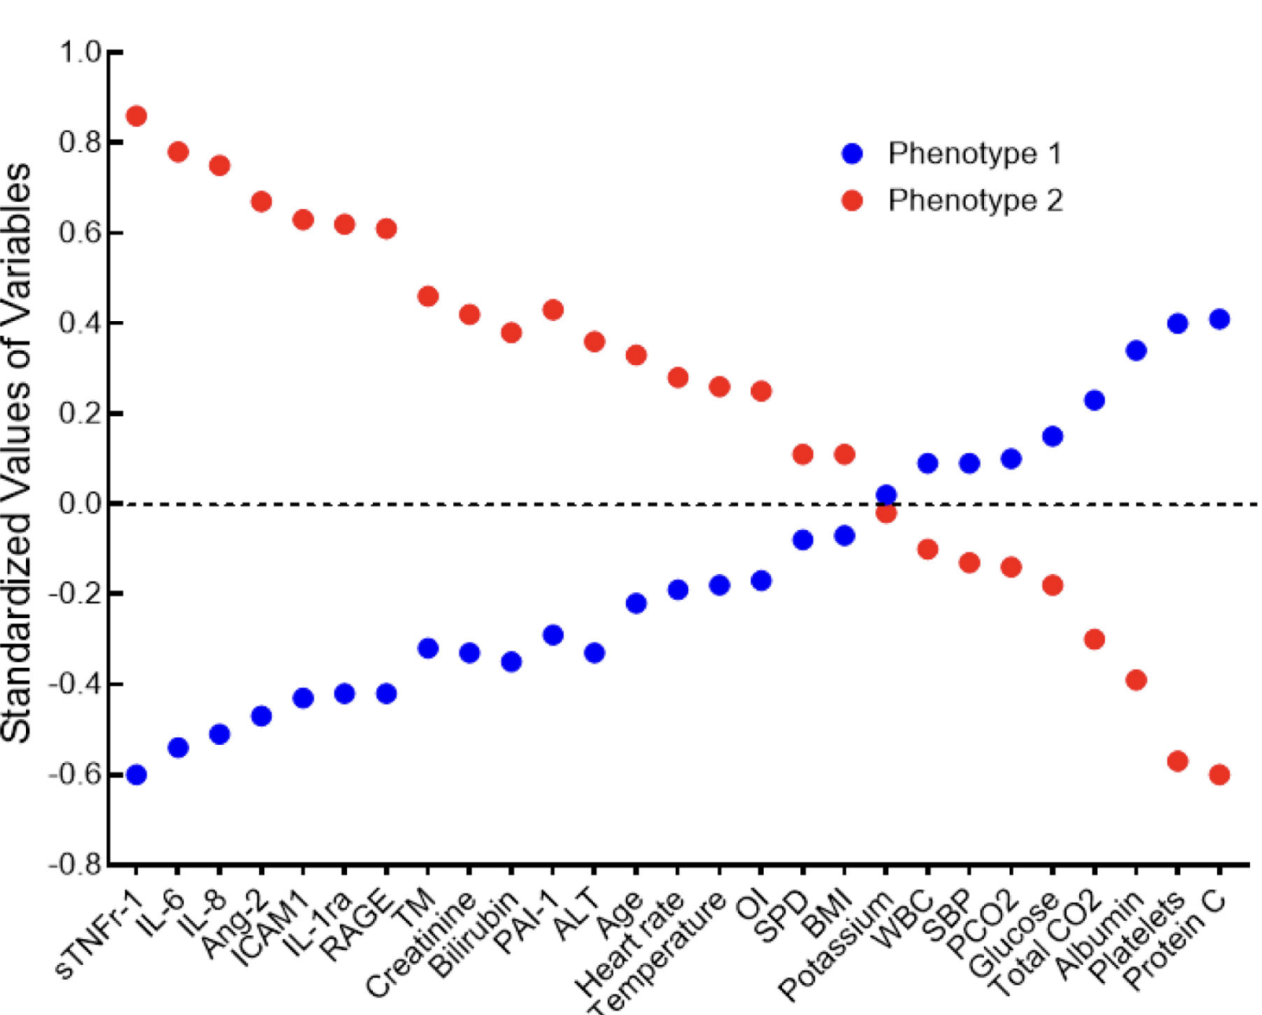
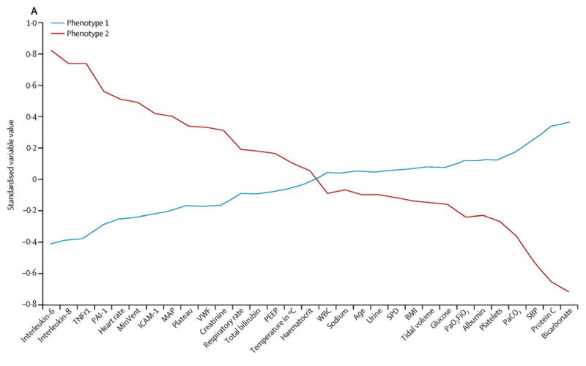
Similar Subphenotypes In both ARDS and Pediatric ARDS (PARDS)
Adult
Pediatric
Hypoinflammatory
Hyperinflammatory
Hypoinflammatory
Hyperinflammatory
Calfee CS et al. Lancet Respir Med. 2014;2(8)
Dahmer MK et al. Lancet Respir Med. 2022;10(3)
Notes:
Similar to adults with ARDS, our group previously used latent class analysis to identify two inflammatory subphenotypes in pediatric ARDS.
Also called “hyperinflammatory” and “hypoinflammatory", these subphenotypes that have very similar clinical and biomarker profiles to their respective adult counterparts.
And our "hyperinflammatory" subphenotype also had significantly worse outcomes

Slide 4
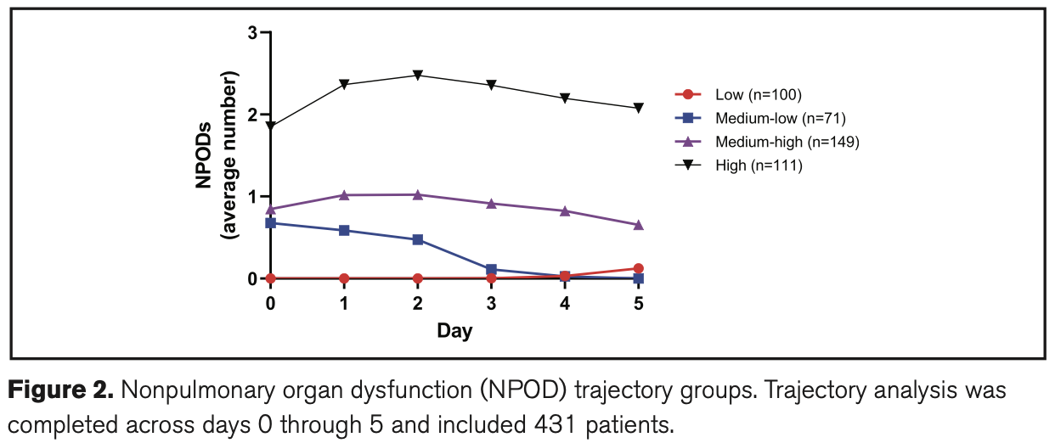
Four Non-Pulmonary Organ Dysfunction (NPOD) Trajectories
Average Number of Failing Organs
(In Addition to Respiratory Failure)
High (n=111)
Medium-High (n=149)
Medium-Low (n=71)
Low (n=100)
Ardila SM et al. Pediatric Critical Care Medicine. 2023;24(9)
Notes:
Using the same ancillary study, we have also used a longitudinal trajectory analysis of patients with acute respiratory failure, including the pediatric ARDS patients from the previous analysis, and retrospectively identified four progressively worsening non-pulmonary organ dysfunction (NPOD) trajectories, each with around 100 patients.
Here you can see how the average number of failing organs (in addition to acute respiratory failure) varied across the first five days after intubation.
Staring from the bottom red line, the “Low” trajectory had very little additional organ failure outside of respiratory failure
Moving up to the blue and purple lines, the “Medium-Low” and the “Medium-High ” trajectories started out with close to one additional failing organ on top of respiratory failure on average. However whereas the “Medium-Low” trajectory improved over the subsequent five days, the “Medium-High” group continued to have multi-organ failure
Finally, those shown in black line at the top, the “High” trajectory had around two additional organs failing at the time of intubation and this persisted across the following five days
These middle trajectories were important because, at the time of intubation, there was no way to predict which patients would fall into the Medium-Low versus the Medium-High trajectory

Slide 5
Hypothesis: Hyperinflammatory Subphenotype will be Associated with Worsening NPOD Trajectories
Pediatric
Hypoinflammatory
Hyperinflammatory
∝
Average Number of Failing Organs
(In Addition to Respiratory Failure)
Dahmer MK et al. Lancet Respir Med. 2022;10(3)
Ardila SM et al. Pediatric Critical Care Medicine. 2023;24(9)
Notes:
Currently the relationship between pediatric inflammatory subphenotype and organ failure trajectories is unknown.
Our goal was to determine the association between subphenotype assignment within the first 48 hours after intubation and the non-pulmonary organ dysfunction trajectories across the subsequent five days
We hypothesized that the hyperinflammatory subphenotype will be associated with increasing NPOD trajectories

Slide 6
Methods
Secondary analysis of RESTORE clinical trial and the BALI ancillary study
RESTORE RCT: Protocolized Sedation vs Usual Care in Pediatric Patients Mechanically Ventilated for Acute Respiratory Failure
BALI ancillary study: Genetic Variation and Biomarkers in Children with Acute Lung Injury
Patient Selection:
RESTORE cohort: 2449 patients
Total BALI cohort with subphenotype assignment: 426 patients
Hyperinflammatory: 66% (n=254), Hypoinflammatory: 34% (n=123)
Final cohort with complete NPOD trajectory data: 383 patients
Multivariable ordinal logistic regression
Notes:
This is a secondary analysis of the RESTORE clinical trial (a sedation trial in pediatric critical care medicine) and the BALI ancillary study.
RESTORE was a randomized clinical trial of pediatric patients with acute respiratory failure requiring invasive mechanical ventilation, and the use of a Protocolized Sedation vs Usual Care
BALI was an ancillary study to this that established a separate biorepository to analyze biomarker variation amongst these patients
The entire RESTORE cohort consisted of close to 2500 patients
Latent Class Analysis and subphenotype assignment was able to be performed on 426 BALI patients.
Of these, 383 had complete NPOD trajectory data, giving us our final cohort
Two-thirds (66%, n=254) of our final cohort had a hypoinflammatory subphenotype and one-third (34%, n=123) had a hyperinflammatory subphenotype
We performed multivariable ordinal logistic regression to compare the subphenotype assignment to an increasing NPOD trajectory
The Wald test was used to ensure that increasing NPOD trajectories satisfied the proportional odds assumption.

Slide 7
Worse NPOD Trajectory Associated with Increasing Proportion of Hyperinflammatory Subphenotype
Notes:
We then looked at the proportion of patients with a hyperinflammatory subphenotype across the organ failure trajectories.
With each step up in organ failure trajectory, there is an associated increase in the proportion of patients with the hyperinflammatory subphenotype.
Increasing from 5% to 12% to 34% to 73%
It is also important to note that patients with a hyperinflammatory subphenotype were present across all NPOD trajectories

Slide 8
Clinical Covariates Associated with
Worse NPOD Trajectories
NPOD Trajectory (n=383)
 | Low (n=87) | Medium-Low (n=65) | Medium-High (n=132) | High (n=99) | p-value
Age (y), median (IQR)* | 1.1 (0.3-4.1) | 2.0 (0.6-8.0) | 6.9 (1.0-12.1) | 7.3 (1.9-15.1) | <0.001
Female | 38 (43.7%) | 34 (52.3%) | 60 (45.5%) | 46 (46.5%) | 0.749
Primary Diagnosis
Sepsis* | 1 (1.1%) | 3 (4.6%) | 25 (18.9%) | 43 (43.4%) | <0.001
Bronchiolitis* | 37 (42.5%) | 12 (18.5%) | 20 (15.2%) | 4 (4.0%) | <0.001
Pneumonia | 25 (28.7%) | 25 (38.5%) | 58 (43.9%) | 29 (29.3%) | 0.052
Other | 24 (27.6 %) | 25 (15.4 %) | 29 (22 %) | 23 (23.2 %)
Past Medical History
Asthma† | 15 (17.2%) | 24 (36.9%) | 23 (17.4%) | 6 (6.1%) | <0.001
Cancer* | 0 (0.0%) | 1 (1.5%) | 8 (6.1%) | 15 (15.2%) | <0.001
Prematurity | 10 (11.5%) | 10 (15.4%) | 15 (11.4%) | 10 (10.1%) | 0.764
PARDS† | 59 (67.8%) | 36 (55.4%) | 93 (70.5%) | 81 (81.8%) | 0.004
*=Included in final model
†=Included in initial model, removed after backwards elimination
Notes:
We used a combination of directed acyclic graphs (DAGs) and bivariate analysis to identify the co-variates that we wanted to include in our model.

Slide 9
Clinical Covariates Associated with
Worse NPOD Trajectories
NPOD Trajectory (n=383)
 | Low (n=87) | Medium-Low (n=65) | Medium-High (n=132) | High (n=99) | p-value
Age (y), median (IQR)* | 1.1 (0.3-4.1) | 2.0 (0.6-8.0) | 6.9 (1.0-12.1) | 7.3 (1.9-15.1) | <0.001
Female | 38 (43.7%) | 34 (52.3%) | 60 (45.5%) | 46 (46.5%) | 0.749
Primary Diagnosis
Sepsis* | 1 (1.1%) | 3 (4.6%) | 25 (18.9%) | 43 (43.4%) | <0.001
Bronchiolitis* | 37 (42.5%) | 12 (18.5%) | 20 (15.2%) | 4 (4.0%) | <0.001
Pneumonia | 25 (28.7%) | 25 (38.5%) | 58 (43.9%) | 29 (29.3%) | 0.052
Other | 24 (27.6 %) | 25 (15.4 %) | 29 (22 %) | 23 (23.2 %)
Past Medical History
Asthma† | 15 (17.2%) | 24 (36.9%) | 23 (17.4%) | 6 (6.1%) | <0.001
Cancer* | 0 (0.0%) | 1 (1.5%) | 8 (6.1%) | 15 (15.2%) | <0.001
Prematurity | 10 (11.5%) | 10 (15.4%) | 15 (11.4%) | 10 (10.1%) | 0.764
PARDS† | 59 (67.8%) | 36 (55.4%) | 93 (70.5%) | 81 (81.8%) | 0.004
*=Included in final model
†=Included in initial model, removed after backwards elimination
Notes:
After backwards elimination, our final model controlled for:
age,
the primary diagnoses of sepsis and bronchiolitis,
and cancer

Slide 10
Clinical Covariates Associated with
Worse NPOD Trajectories
NPOD Trajectory (n=383)
 | Low (n=87) | Medium-Low (n=65) | Medium-High (n=132) | High (n=99) | p-value
Age (y), median (IQR)* | 1.1 (0.3-4.1) | 2.0 (0.6-8.0) | 6.9 (1.0-12.1) | 7.3 (1.9-15.1) | <0.001
Female | 38 (43.7%) | 34 (52.3%) | 60 (45.5%) | 46 (46.5%) | 0.749
Primary Diagnosis
Sepsis* | 1 (1.1%) | 3 (4.6%) | 25 (18.9%) | 43 (43.4%) | <0.001
Bronchiolitis* | 37 (42.5%) | 12 (18.5%) | 20 (15.2%) | 4 (4.0%) | <0.001
Pneumonia | 25 (28.7%) | 25 (38.5%) | 58 (43.9%) | 29 (29.3%) | 0.052
Other | 24 (27.6 %) | 25 (15.4 %) | 29 (22 %) | 23 (23.2 %)
Past Medical History
Asthma† | 15 (17.2%) | 24 (36.9%) | 23 (17.4%) | 6 (6.1%) | <0.001
Cancer* | 0 (0.0%) | 1 (1.5%) | 8 (6.1%) | 15 (15.2%) | <0.001
Prematurity | 10 (11.5%) | 10 (15.4%) | 15 (11.4%) | 10 (10.1%) | 0.764
PARDS† | 59 (67.8%) | 36 (55.4%) | 93 (70.5%) | 81 (81.8%) | 0.004
*=Included in final model
†=Included in initial model, removed after backwards elimination
Notes:
After backwards elimination, our final model controlled for:
age,
the primary diagnoses of sepsis and bronchiolitis,
and cancer

Slide 11
Hyperinflammatory Subphenotype
Independently Associated with Worse NPOD Trajectories
Multivariable Ordinal Logistic Regression: Odds of Increasing NPOD Trajectory
 | aOR* | 95% CI |  | P-value
Hyperinflammatory Subphenotype | 6.35 | 3.89- | 10.37 | <0.000
Age (years) | 1.05 | 1.01- | 1.09 | 0.017
Cancer (Current or Past) | 4.24 | 1.85- | 9.69 | 0.001
Sepsis | 3.56 | 1.98- | 6.38 | <0.000
Bronchiolitis | 0.46 | 0.26- | 0.80 | 0.006
*Adjusted for: Age, Cancer (current or past), Sepsis, Bronchiolitis
Notes:
Finally, we performed a Multivariable Ordinal Logistic Regression
We found that the patients with a hyperinflammatory subphenotype had over 6 times the odds of being in a higher NPOD trajectory
Because our model satisfies the proportional odds assumption,
This odds ratio applies to every combination of lower NPOD trajectories as compared to higher NPOD trajectories
Meaning that, for a patient between organ failure trajectories, given they have a hyperinflammatory subphenotype, the odds of being in a worse organ failure trajectory was 6.4

Slide 12
Worse NPOD Trajectories Have Worse Outcomes
NPOD Trajectory (n=383)
 | Low (n=87) | Medium-Low (n=65) | Medium-High (n=132) | High (n=99) | p-value†
Died | 0 (0.0%) | 0 (0.0%) | 8 (6.1%) | 22 (22.2%) | <0.001
Duration of Mechanical Ventilation* | 5.0 (2.9-7.7) | 4.9 (3.0-6.9) | 7.2 (4.1-14.3) | 12.5 (7.5-28.0) | <0.001
Hospital Length of Stay* | 12.0 (7.0-19.0) | 11.0 (8.0-15.0) | 17.0 (10.0-32.0) | 32.0 (18.0-53.0) | <0.001
*days, median (IQR)
Notes:
First, we looked at outcomes across the different NPOD trajectories.
Outcomes are significantly different between NPOD trajectories with the high NPOD trajectory having worse outcomes
P-value test for the trend across NPOD trajectories was performed using Cochran-Armitage test for categorical variables and and Cuzick’s test for continuous variables with 10,000 Monte Carlo permutations. Death: number (percentage). Duration of Mechanical Ventilation, PICU Length of Stay, Hospital Length of Stay: Days, median (IQR). NPOD: Non-Pulmonary Organ Dysfunction, IQR: Interquartile Range, PICU: Pediatric Intensive Care Unit.
Looking at mortality between the groups, you can see why it may be important to be able to prospectively identify all patients, but specifically those patients that will be in the Medium-Low vs Medium-High Trajectories
Outcomes to explain:
Duration of mechanical ventilation is similar to, but the inverse of ventilator-free days. Patients were assigned 28 days if they remained intubated or died prior to day 28.

Slide 13
Key Take Aways
Assignment to the hyperinflammatory subphenotype soon after intubation is independently associated with a worsening organ failure trajectories
Worsening organ failure trajectories were associated with worse clinical outcomes
Two related but separate dimensions of critical care
Notes:
In this cohort of pediatric patients with ARF, assignment to the hyperinflammatory subphenotype assignment in the first 48 hours after intubation was independently associated with a worsening trajectory of non-pulmonary organ system failure
This may be useful as a predictive enrichment tool when designing future randomized controlled trials of multi-organ failure
Additionally, may be useful clinically as a prognostic enrichment tool for subsequent organ system failures
For example, if you remember back to the NPOD trajectories,
Both the medium-low and the medium-high NPOD trajectories had respiratory failure and one additional organ failure on average at the time of intubation. But then they diverged over the subsequent 5 days
The “Medium-High” trajectory had significantly longer duration of mechanical ventilation and higher mortality, despite appearing similar the “Medium-Low” trajectory at the time of intubation
Our study shows that if may be possible to use inflammatory subphenotype assignment to help risk stratify these patients specifically

Slide 14
Conclusion & Next Steps
Potential for early prognostic enrichment
Medium-Low vs Medium-High Trajectories
Predictive enrichment in the design of future randomized controlled trials of multi-organ failure
Average Number of Failing Organs
(In Addition to Respiratory Failure)
High (n=111)
Medium-High (n=149)
Medium-Low (n=71)
Low (n=100)
Ardila SM et al. Pediatric Critical Care Medicine. 2023;24(9)
Notes:
In this cohort of pediatric patients with ARF, assignment to the hyperinflammatory subphenotype assignment in the first 48 hours after intubation was independently associated with a worsening trajectory of non-pulmonary organ system failure
This may be useful as a predictive enrichment tool when designing future randomized controlled trials of multi-organ failure
Additionally, may be useful clinically as a prognostic enrichment tool for subsequent organ system failures
For example, if you remember back to the NPOD trajectories,
Both the medium-low and the medium-high NPOD trajectories had respiratory failure and one additional organ failure on average at the time of intubation. But then they diverged over the subsequent 5 days
The “Medium-High” trajectory had significantly longer duration of mechanical ventilation and higher mortality, despite appearing similar the “Medium-Low” trajectory at the time of intubation
Our study shows that if may be possible to use inflammatory subphenotype assignment to help risk stratify these patients specifically
The High NPOD trajectory is characterized by persistent respiratory, cardiovascular, and neurologic failure (17).
This organ failure pattern closely resembles the previously described “Persistent Hypoxemia, Encephalopathy, and Shock” (PHES) subphenotype
first identified in children with sepsis-associated MODS (14, 15, 24).
The PHES subphenotype has been consistently linked to worse outcomes in critically ill children phenotype and has been
associated with heterogeneous responses to targeted therapies, including hydrocortisone and early albumin administration (24–27).
Interestingly, 73% of the patients in High NPOD trajectory belonged to the hyperinflammatory subphenotype,
which can be identified using a validated, three biomarker based, parsimonious model (8, 9).
Two of the three biomarkers in the parsimonious model are (IL-6) and interleukin-8 (IL-8).
Interestingly, cytokine profiling of 50 patients with the PHES phenotype has demonstrated significantly higher levels of IL-6 and IL-8 compared with patients with sepsis-associated MODS without PHES (28).
This suggests that the hyperinflammatory subphenotype and the PHES subphenotype may be related.
Given this, our next step is to validate these findings in other cohorts of pediatric patients with multi-organ failure

Slide 15
Conclusion & Next Steps
Similarities to other independently derived organ failure trajectories
“Persistent Hypoxemia, Encephalopathy, and Shock” (PHES) in sepsis associated MODS
Next Step
Prospective validation in other pediatric cohorts with MODS
Sanchez-Pinto LN et al. Pediatric Critical Care Medicine. 2023;24(11)
Hurtado RR, Sanchez-Pinto LN. Sci Rep. 2025;15
Notes:
In this cohort of pediatric patients with ARF, assignment to the hyperinflammatory subphenotype assignment in the first 48 hours after intubation was independently associated with a worsening trajectory of non-pulmonary organ system failure
This may be useful as a predictive enrichment tool when designing future randomized controlled trials of multi-organ failure
Additionally, may be useful clinically as a prognostic enrichment tool for subsequent organ system failures
For example, if you remember back to the NPOD trajectories,
Both the medium-low and the medium-high NPOD trajectories had respiratory failure and one additional organ failure on average at the time of intubation. But then they diverged over the subsequent 5 days
The “Medium-High” trajectory had significantly longer duration of mechanical ventilation and higher mortality, despite appearing similar the “Medium-Low” trajectory at the time of intubation
Our study shows that if may be possible to use inflammatory subphenotype assignment to help risk stratify these patients specifically
The High NPOD trajectory is characterized by persistent respiratory, cardiovascular, and neurologic failure (17).
This organ failure pattern closely resembles the previously described “Persistent Hypoxemia, Encephalopathy, and Shock” (PHES) subphenotype
first identified in children with sepsis-associated MODS (14, 15, 24).
The PHES subphenotype has been consistently linked to worse outcomes in critically ill children phenotype and has been
associated with heterogeneous responses to targeted therapies, including hydrocortisone and early albumin administration (24–27).
Interestingly, 73% of the patients in High NPOD trajectory belonged to the hyperinflammatory subphenotype,
which can be identified using a validated, three biomarker based, parsimonious model (8, 9).
Two of the three biomarkers in the parsimonious model are (IL-6) and interleukin-8 (IL-8).
Interestingly, cytokine profiling of 50 patients with the PHES phenotype has demonstrated significantly higher levels of IL-6 and IL-8 compared with patients with sepsis-associated MODS without PHES (28).
This suggests that the hyperinflammatory subphenotype and the PHES subphenotype may be related.
Given this, our next step is to validate these findings in other cohorts of pediatric patients with multi-organ failure

Slide 16
Franklin Privette MD privettf@med.umich.edu
Thank You
Conclusion
Assignment to the hyperinflammatory subphenotype soon after intubation is independently associated with a worsening trajectory of non-pulmonary organ system failure

Slide 17
Demographics
 | Total (n=383)
Age (y), median (IQR) | 4.05 (0.71-11.21)
Female | 178 (46.5%)
Primary Diagnosis
Sepsis | 72 (18.8%)
Pneumonia | 137 (35.8%)
Bronchiolitis | 73 (19.1%)
Other | 101 (26.4%)
Past Medical History
Asthma | 68 (17.8%)
Cancer | 24 (6.3%)
Prematurity | 45 (11.7%)
PARDS | 269 (70.2%)
PRISM Score*, median (IQR) | 8.00 (4.00-13.00)
* Disease Severity Score at ICU Admission

Slide 18
Two Related But Separate Dimensions of Critical Illness
Interaction between NPOD Trajectory and Inflammatory Subphenotype
 | Died, Percent of NPOD Trajectory |  |  | Duration of Mechanical Ventilation (d), median (IQR)
 | Hyperinflammatory | Hypoinflammatory | p-value | Hyperinflammatory | Hypoinflammatory | p-value
Low (n=87) | 0% | 0% | 0.67 | 6.58 (4.60-7.40) | 4.92 (2.91-7.70) | 0.83
Medium-Low (n=65) | 0% | 0% |  | 6.78 (5.36-9.52) | 4.71 (2.88-6.24)
Medium-High (n=132) | 9% | 5% |  | 9.24 (5.04-15.20) | 6.77 (4.11-12.81)
High (n=99) | 25% | 15% |  | 13.78 (7.49-28.00) | 10.89 (6.78-24.04)
Notes:
ª Logistic Regression with Firth correction for separation
^{b} Negative Binomial Regression
^{c} Adjusted for: Age, Cancer (current or past)^{d}, Sepsis, Bronchiolitis
^{d} Past medical history of cancer was combined with current cancer with to capture all patients with new or prior cancer diagnoses

Slide 19
Clinical Outcomes within
Each Subphenotype and by NPOD Trajectory
NPOD Trajectory
 | Low (n=87) | Medium-Low (n=65) | Medium-High (n=132) | High (n=99) | p-value
Hyperinflammatory
Died | 0 (0.0%) | 0 (0.0%) | 4 (8.9%) | 18 (25.0%) | 0.067
Duration of Mechanical Ventilation days, median (IQR) | 6.6 (4.6-7.4) | 6.8 (5.4-9.5) | 9.2 (5.0-15.2) | 13.8 (7.5-28.0) | 0.004
Hypoinflammatory
Died | 0 (0.0%) | 0 (0.0%) | 4 (4.6%) | 4 (14.8%) | <0.001
Duration of Mechanical Ventilation days, median (IQR) | 4.9 (2.9-7.7) | 4.7 (2.9-6.2) | 6.8 (4.1-12.8) | 10.9 (6.8-24.0) | <0.001

Slide 20
Multivariable Ordinal Logistic Regression
Model | Variable | OR | 95% CI |  | P-value | BIC
Unadjusted | Hyperinflammatory | 11.22 | 7.04 | 17.89 | 0.000
Multivariable | Hyperinflammatory | 5.46 | 3.27 | 9.09 | 0.000 | 906.707
 | Age | 1.05 | 1.01 | 1.09 | 0.011
 | Cancer (Current or Past) | 3.99 | 1.75 | 9.07 | 0.001
 | Sepsis | 3.38 | 1.88 | 6.10 | 0.000
 | Asthma | 0.61 | 0.33 | 1.11 | 0.104
 | Bronchiolitis | 0.39 | 0.22 | 0.70 | 0.002
 | PARDS | 1.30 | 0.85 | 2.00 | 0.222
Multivariable - PARDS | Hyperinflammatory | 5.80 | 3.51 | 9.57 | 0.000 | 902.247
 | Age | 1.05 | 1.01 | 1.09 | 0.011
 | Cancer (Current or Past) | 3.97 | 1.74 | 9.07 | 0.001
 | Sepsis | 3.33 | 1.85 | 6.00 | 0.000
 | Asthma | 0.59 | 0.32 | 1.08 | 0.090
 | Bronchiolitis | 0.41 | 0.23 | 0.72 | 0.002
Multivariable - Asthma & PARDS | Hyperinflammatory | 6.35 | 3.89 | 10.37 | 0.000 | 899.189
 | Age | 1.05 | 1.01 | 1.09 | 0.017
 | Cancer (Current or Past) | 4.24 | 1.85 | 9.69 | 0.001
 | Sepsis | 3.56 | 1.98 | 6.38 | 0.000
 | Bronchiolitis | 0.46 | 0.26 | 0.80 | 0.006
Multivariable - Bronchiolitis & PARDS | Hyperinflammatory | 6.21 | 3.77 | 10.24 | 0.000 | 905.898
 | Age | 1.07 | 1.04 | 1.11 | 0.000
 | Cancer (Current or Past) | 4.29 | 1.86 | 9.91 | 0.001
 | Sepsis | 3.81 | 2.12 | 6.85 | 0.000
 | Asthma | 0.74 | 0.41 | 1.33 | 0.314
Multivariable - Bronchiolitis, Asthma, & PARDS | Hyperinflammatory | 6.53 | 4.00 | 10.67 | 0.000 | 900.965
 | Age | 1.07 | 1.03 | 1.11 | 0.000
 | Cancer (Current or Past) | 4.44 | 1.93 | 10.24 | 0.000
 | Sepsis | 3.93 | 2.19 | 7.04 | 0.000

Slide 22
Definitions for Non-Pulmonary Organ System Failures*
Respiratory | Invasive Mechanical Ventilation
Cardiovascular | Any vasoactive medications (single or multiple)
Neurologic | Level of consciousness = stupor or coma, or Non-reactive pupils (one or both)
Hematologic | Platelet count < 80,000 cells/mL
Hepatic | Alanine transaminase (ALT) > 2 times upper limit of normal for age and sex, or Total bilirubin ≥ 4 mg/dL
Renal | Serum creatinine > 2 times upper limit of normal for age
 |  | *defined as described in the RESTORE clinical trial

Slide 24
Utilization of Neurally adjusted ventilatory assist (NAVA) across pediatric critical care centers: a clinician-based survey Megan Kabara do University of Michigan Division of Pediatric Critical care 2/18/26

Slide 25
Research Goal:
My long-term academic goal is to improve outcomes for critically ill children by defining how pediatric intensive care providers can optimally select and apply respiratory support modalities for specific disease states.
Notes:
My motivation for this area of research is there are a lot of respiratory therapies with insufficient evidence to support bedside decision making
To start my investigative journey I am choosing to look at NAVA and first understand the barriers to use and how it is currently being used in PICU as this with help set the groundwork for future projects.

Slide 26
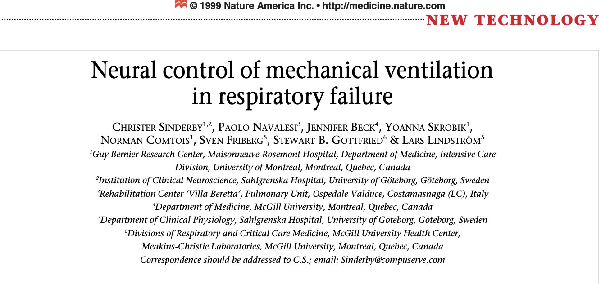
Background:
Notes:
Chris Sinderby introduced the idea about a neural trigger for initiation of mechanical support in the intubated patient instead of the conventional flow or pressure trigger
The hypothesis is that this will lead to better synchrony between the patient and the ventilator, decrease the wasted efforts, and potentially provide a shorter time of intubation.

Slide 27
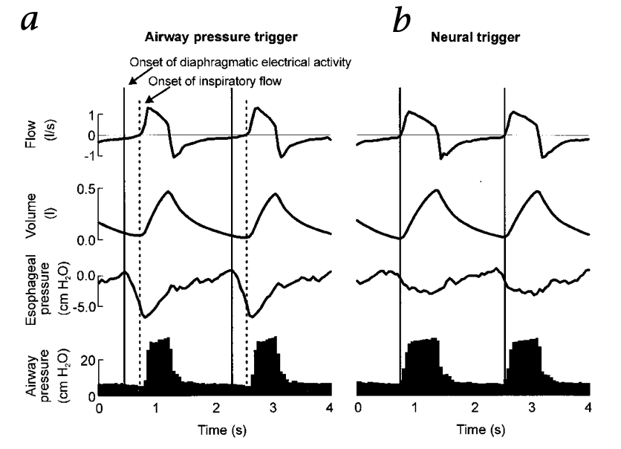
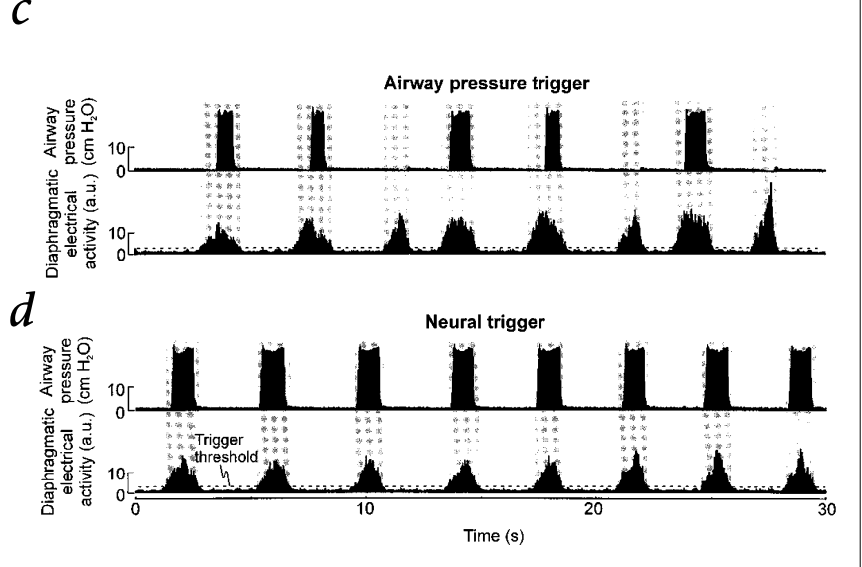
Neural trigger leads to reduction in wasted respiratory efforts
(Sinderby, C. Nature Vol. 5 Issue 12)
Notes:
Work of breathing can be decreased if the onset of inspiratory effort and mechanical assistance is shortened
Poorly coordinated with the respiratory support with results in completely wasted inspiratory efforts.
Goal with NAVA is to match ventilatory support with patient demand by using the diaphragmatic activity as the trigger.

Slide 28



Overview of pediatric data is a gap…
Reduction in AI
Reduce time of ventilator?
Reduction of sedation?
Notes:
In the pediatric literature it has been clearly defined by multiple studies that NAVA can reduce AI
Why reduction in AI can be helpful: reduced wasted effort= more recovery, more comfortable= less sedation new mode it has not paned out in other context
However this has not yet been shown in the pediatric data yet
The Pediatric data has shown some degree of significant lower PIP and Fi02
Adult study: reduction in driving pressure

Slide 29



There is a gap…
Few Prior Studies
Unclear population
Limited Data Availability
Notes:
The gap is limited evidence constrained by single center study designs, small study cohorts, and lack of multicenter pediatric randomized control trials confirming the benefit of NAVA. It is also unclear which patients benefit most or which clinical outcomes are most impacted.
- What is needed are large multi center studies to determine if reduction in patient ventilator asynchrony that is observed with NAVA use results in clinically meaningful decreases in duration of mechanical ventilation
Who are the ideal pediatric patients that would benefit from NAVA
There is no database for NAVA this is not available (PHIS, VPS, EHR) and very infrequent use at our center for a single study design given this decided to conduct a survey

Slide 30

To address this gap…
Notes:
First need to understand the landscape before we can obtain multi-venter analysis to do this I created a survey to by understand how NAVA is being used in the pediatric critical care units as well as to understand barriers to its use. This will then help me to target specific barriers to increase use as well as hope to gain interest in creating NAVA use in a database for multi center studies which NAVA research is currently lacking.

Slide 31
Utilization of Neurally Adjusted Ventilatory Assist Across Pediatric Critical Care Centers: A Clinician-Based Survey
Notes:
My project aims to help bridge the gap in knowledge by evaluating provider perceptions on NAVA, current utilization, and specific applications regarding NAVA in pediatric critical care centers across the US, using a comprehensive survey targeting pediatric critical care physicians

Slide 32
Aims:
Identify the characteristics of centers where NAVA is utilized.
Examine provider experiences, satisfaction levels, training, and barriers to NAVA use.
Determine indications and patient population of NAVA usage.
Notes:
My goal of this project is to gain insight on thoughts about NAVA and how different pediatric centers are using NAVA.
Are there certain characteristics that influence increase NAVA usage.?
Provider, center, and patient

Slide 33
Hypothesis:
We hypothesize that institutional size is independently associated with increased utilization of NAVA in the PICU.
We hypothesize that experience and formal training in NAVA is independently associated with increased provider comfort at the bedside.
We hypothesize that NAVA is used among a heterogenous patient population.

Slide 34
Methods: Study Design and Participants
Created a cross-sectional web-based Qualtrics survey.
Eligible participants included practicing pediatric critical care attendings.
Subsection for medical directors answer additional institutional questions.
Survey distributed through Pediatric Acute Lung Injury and Sepsis Investigators (PALISI) Network.
Email Listserv
Advertised at PALISI Spring Conference
Notes:
Those participants who responded completed questions that included demographics, utilization, perceptions of use, and barrier to NAVA
Participants who responded “no” to usage of NAVA completed questions that included demographics and barrier to why NAVA is not being used.

Slide 35
Breakdown of Responses:
95 Total Responses
18 Does not use NAVA
77 Yes Uses NAVA
4 PICU Medical Directors
20 PICU Medical Directors
Notes:
The next results are among the 77 who have have used NAVA

Slide 36
NAVA most commonly used in patients with ventilatory asynchrony
Reason for NAVA Use: | Number of Responses | % of Respondents (N=77)
Ventilatory asynchrony | 67 | 87.0%
Difficult to wean from vent | 40 | 51.9%
Extubation Failure | 31 | 40.2%
Difficulty with Sedation | 31 | 40.3%
preliminary data, do not share*
Notes:
Total group

Slide 37
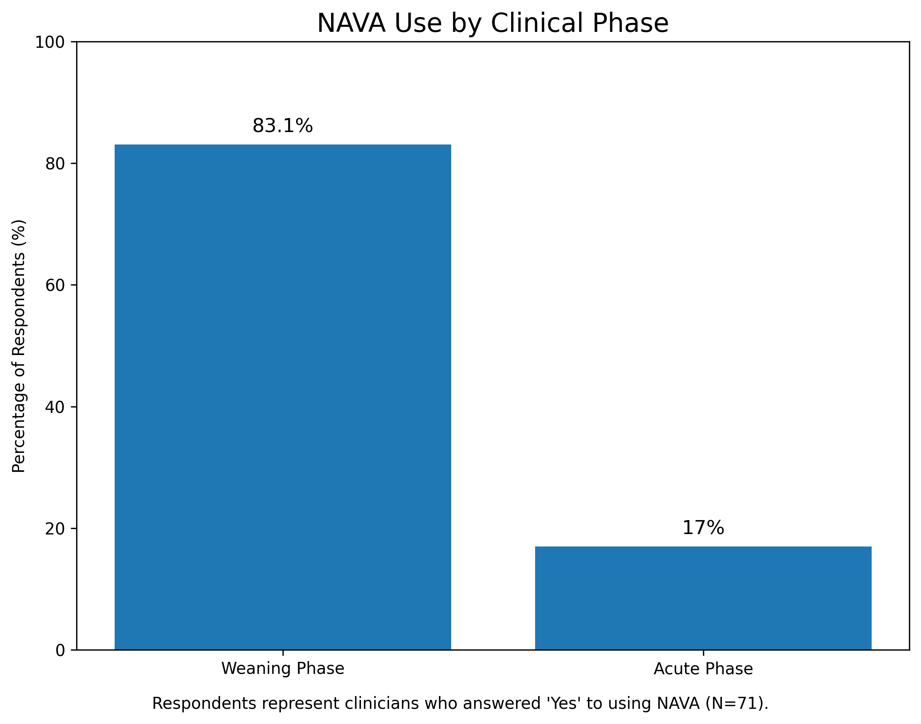
NAVA is most commonly started in weaning phase
preliminary data, do not share*
Notes:
Total group N is 71 because some did not answer the question as they were voluntary questions

Slide 38
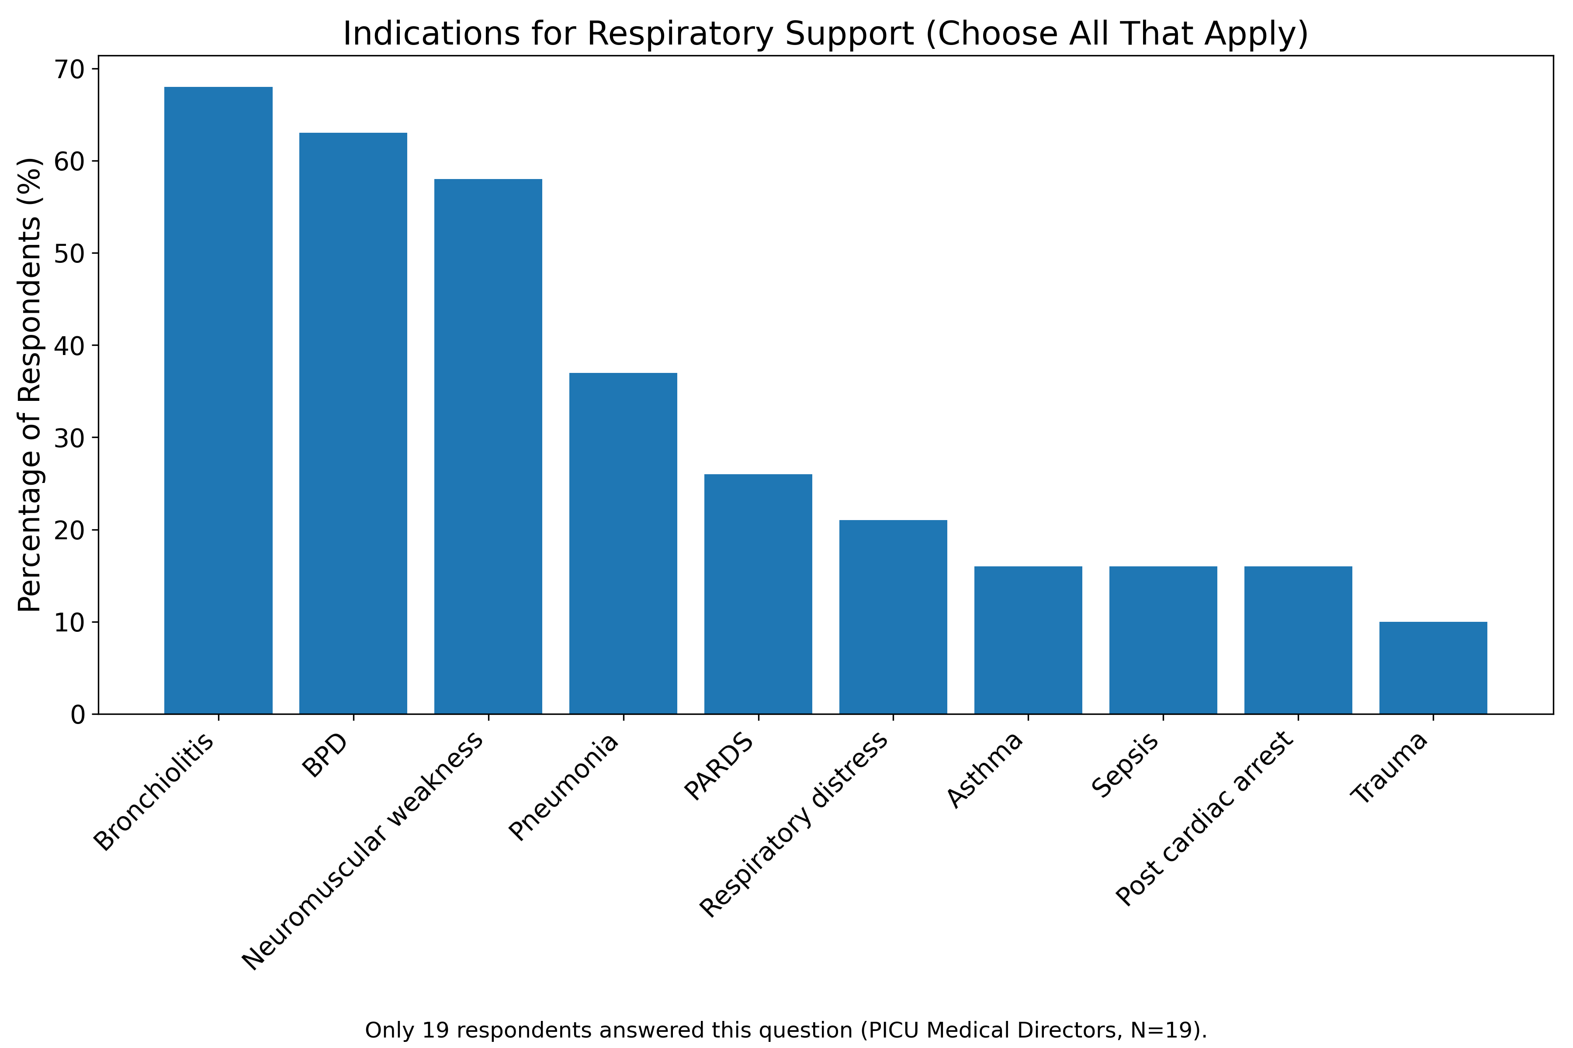
Heterogeneity of NAVA Usage
preliminary data, do not share*
Notes:
This is only the medical director group N=19 problems. This was only in the medical director group because it was marked as institutional questions as the general population may not have a sense of how NAVA is used in their PICU
Top contenders is Bronchiolitis, Neuromuscular weakness, BPD

Slide 39
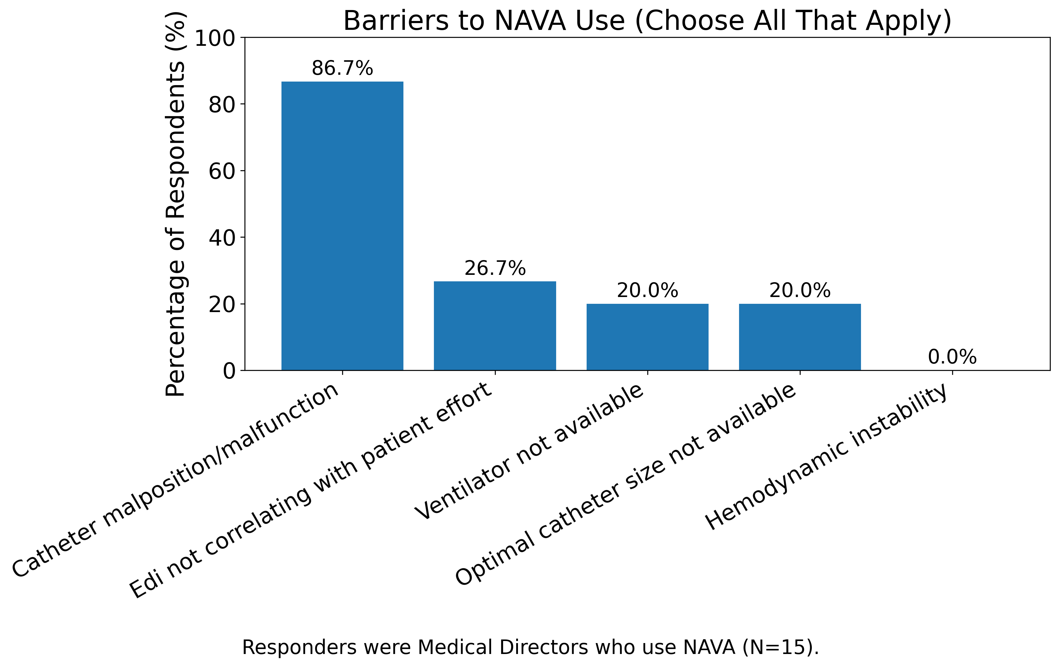
Catheter issues main barrier to NAVA at institutional level
preliminary data, do not share*
Notes:
Those who selected others a lot had to say lack of knowledge or discomfort was their main barrier to use barrier to increase adoption
Number of respondents was 15

Slide 40
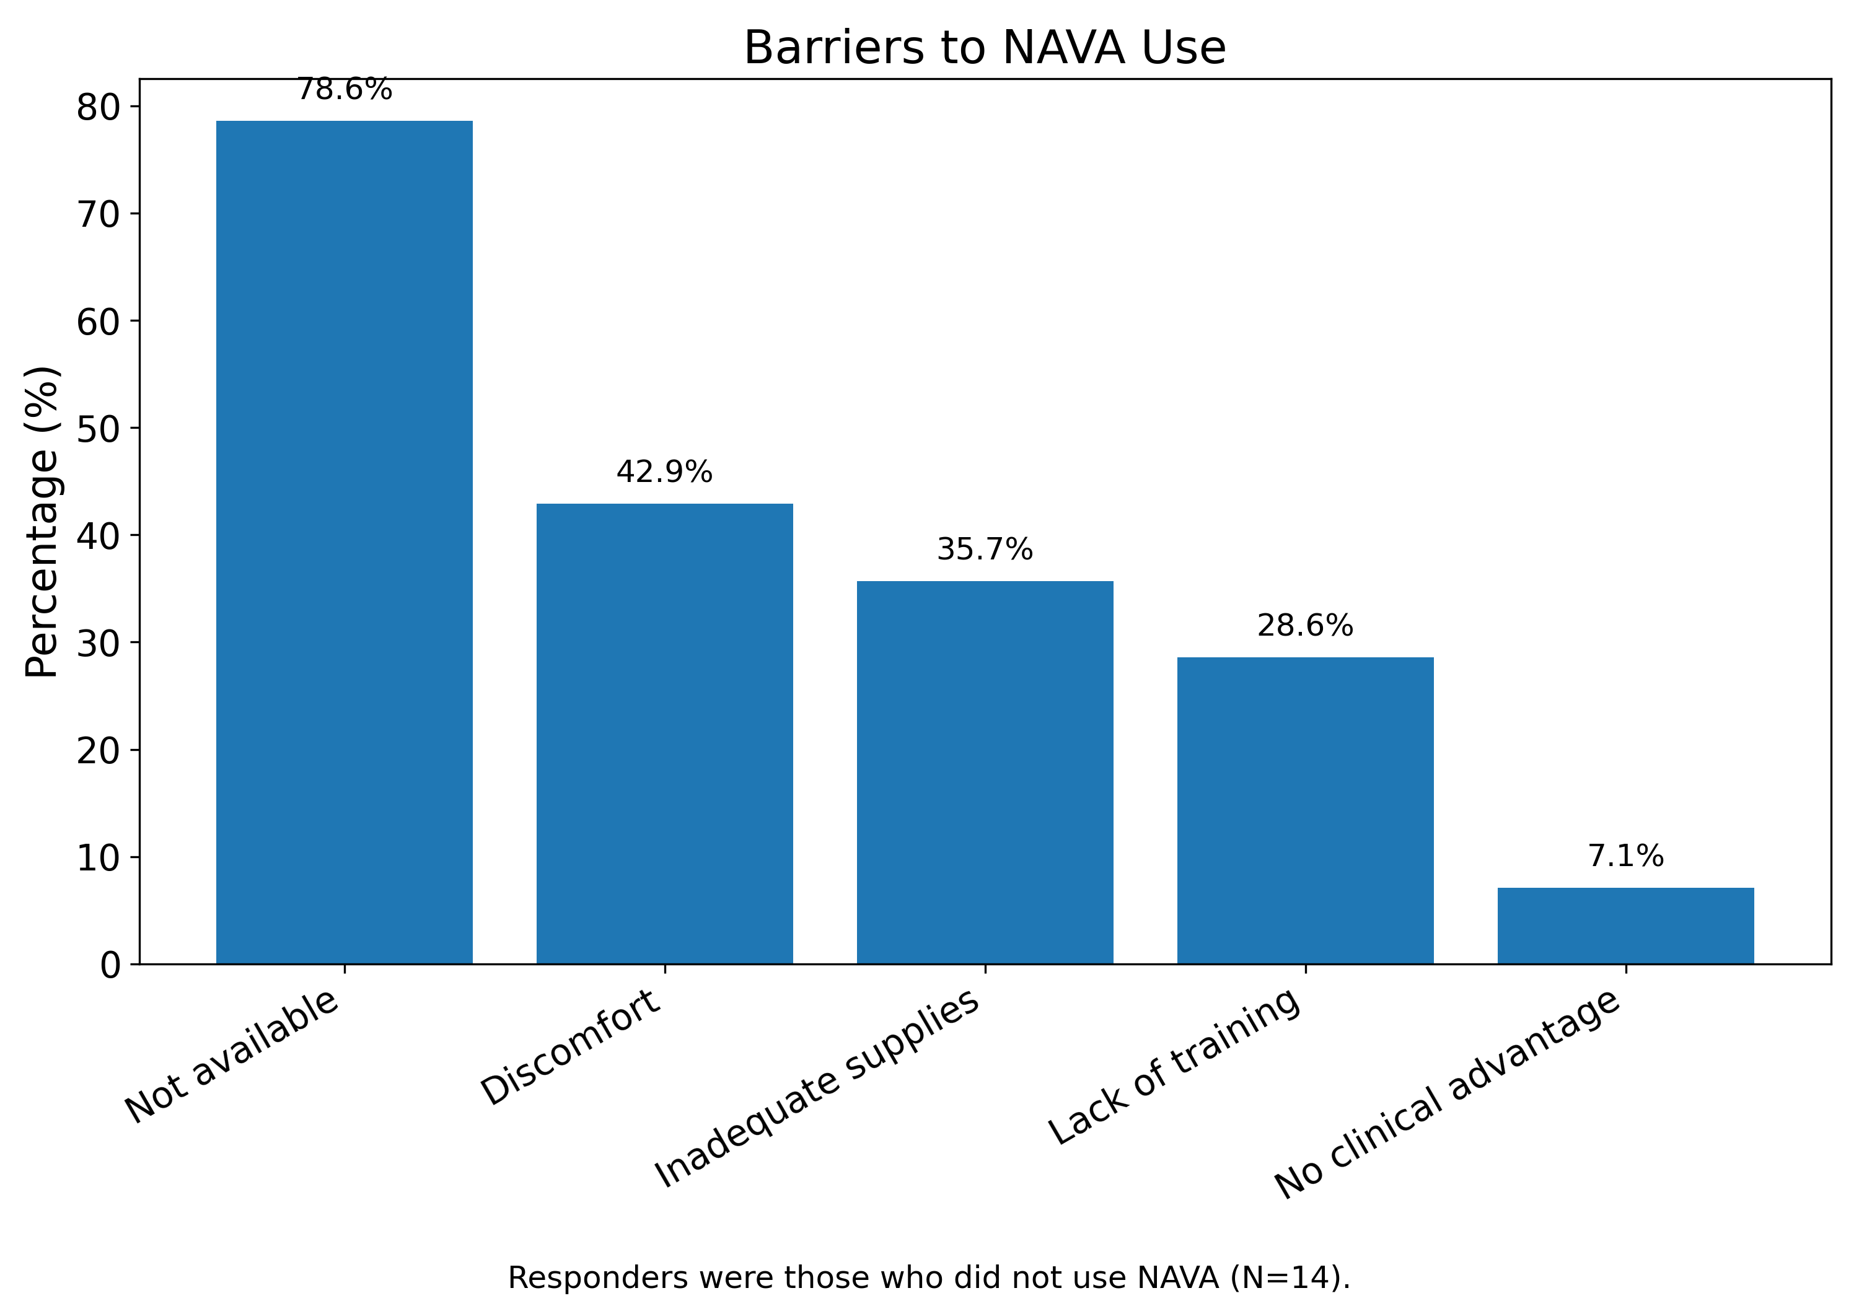
Lack of NAVA usage secondary to lack of availability
preliminary data, do not share*
Notes:
There are out of the group that does not use NAVA
N number is 14

Slide 41
Summary:
Broad use; highest in bronchiolitis, NMW, and BPD.
Top barrier to adoption: availability.
Catheter challenges remain significant.
Notes:
Next, steps will be to complete descriptive analysis and comparative group analysis, create stakeholders for NAVA database inclusion

Slide 42
Next Steps:
Complete descriptive and comparative analysis.
Create stakeholders for NAVA database inclusion.
Create mix-methods approach with NAVA focus group.

Slide 43
Future directions and Questions:
When adopting new technology at the bedside what barriers did you experience?
Adopting new technology at the beside was it more helpful to understand a deeper level of clinician experience vs a broader understanding of real- life use?
Are there collaborators or networks you think would be ideal for expanding this work beyond a survey?
Notes:
What should my next step be focus group or implementation into databases?
How did you get people who were uncomfortable with this technology to use it?

Slide 44
Thank you for your attention!
mkabara@med.umich.edu

Slide 46
ECMO Utilization in “High-Risk” Populations
Zachary Rumlow DO
Pediatric Critical Care Fellow PGY-5
Susan B Meister CHEAR Fellow

Slide 47
Objectives
By the end of this talk attendees should understand:
The differential risk associated with ECMO utilization
Patient and hospital level factors that may be associated with ECMO utilization in “high-risk” patients

Slide 48
Who gets ECMO
Considerations for ECMO Utilization:
Patients with high anticipated mortality with conventional therapies and
Patients who would be more likely to receive benefit than harm from ECMO and
Patients with a reversible/and or transplantable pathology
ASAIO J.: 2020 Indications for Pediatric Respiratory ECMO (Maratta [2020])

Slide 49
Changes in ECMO Contraindications
Absolute contraindications | Conditions rendering patient unlikely to benefit from ECMO
Lethal chromosomal abnormalities (eg. Trisomy 13 or 18) | Large intracranial bleed with mass effect or need for neurosurgical intervention
Severe neurological compromise (eg. Intracranial hemorrhage with mass effect) | Hypoxic cardiac arrest with adequate CPR
Allogenic bone marrow transplant recipients with pulmonary infiltrates | Irreversible underlying cardiac or lung pathology (and not a transplant candidate)
Incurable malignancy | Pulmonary hypertension and chronic lung disease
 | Chronic multiorgan dysfunction
 | Incurable malignancy
 | Allogenic bone marrow recipients with pulmonary infiltrates
ELSO: 2015 Indications for Pediatric Respiratory ECMO (MacLaren [2015]), 2020 Indications for Pediatric Respiratory ECMO (Maratta [2020])
Notes:
Left 2015 ECMO respiratory contraindications has specific absolute contraindications
Right 2020 language is softened
Highlight differences re: removal of T13/18 but that risk is highlighted here w/o explicitly stating it

Slide 50
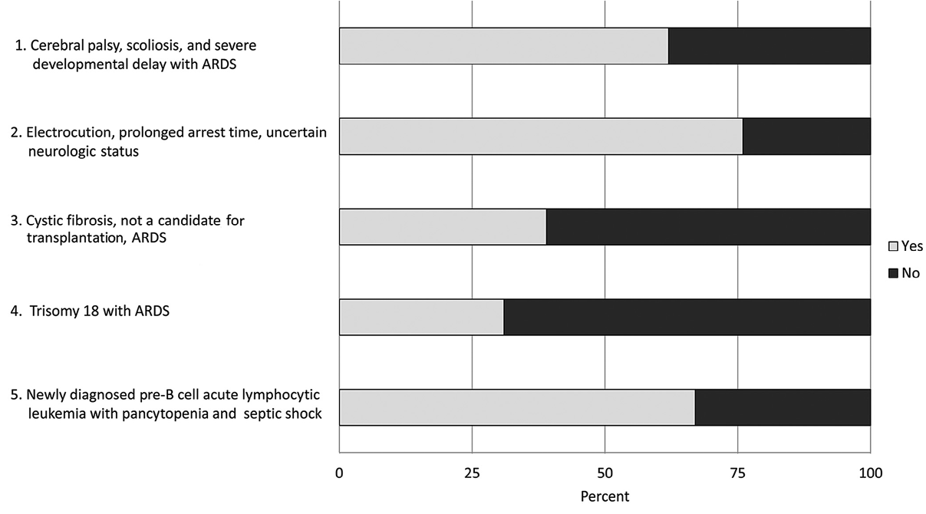
Defining High-Risk Populations
Patients with high anticipated mortality with conventional therapies
Patients who would be more likely to receive benefit than harm from ECMO
Patients with a reversible/and or transplantable pathology
Trauma
Trisomy 13/18
Oncologic
J Pediatr: Should Extracorporeal Membrane Oxygenation Be Offered? An International Survey
(Kuo [2015])

Slide 51
Our Questions
From 2016 – 2024 (excluding 2020) in patients with “high-risk” (Trisomy 13/18, Trauma, Oncologic/Hematopoietic Stem Cell Transplant [HSCT]) diagnoses:
1. have there been changes in rates of ECMO utilization?
2. are there patient and/or hospital level factors that are associated with differences in ECMO utilization?

Slide 52
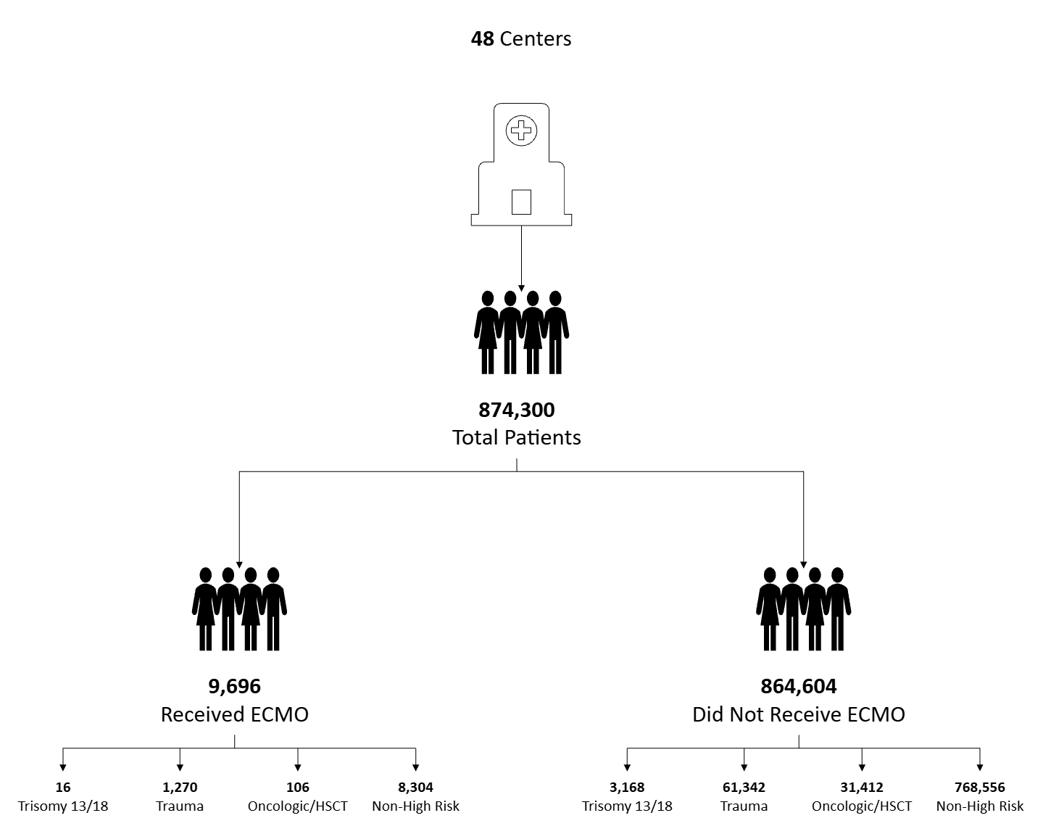
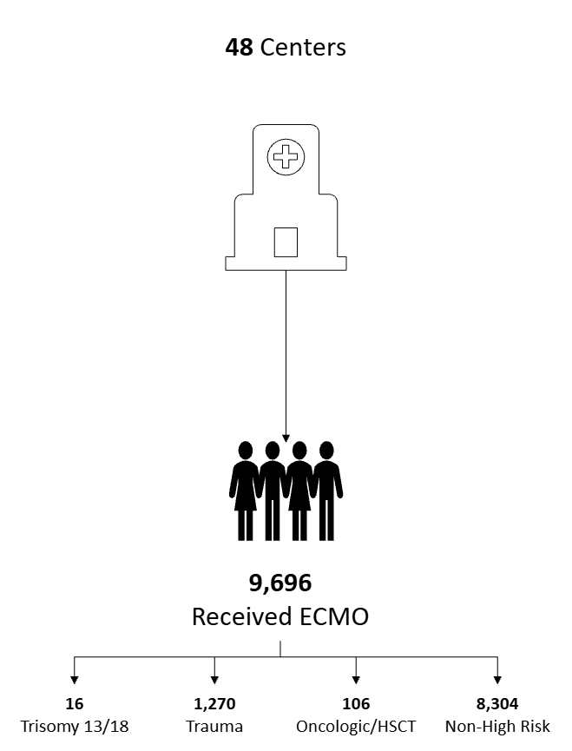
Category | n = 874,300 (%) | ECMO n =9,696 (%) | No-ECMO n = 864,604 (%) | p-value
Age (years), mean [SD] | 874,300 | 4.8 [7.7] | 7.1 [7.3] | < 0.001
Ethnicity | 874,300 |  |  | < 0.001
Hispanic/Latino | 188,349 (21.5) | 1,828 (20.9) | 186,521 (21.3)
Non-Hispanic | 641,896 (73.4) | 7,077 (80.9) | 634,819 (72.6)
Missing | 44,055 (5.0) | 791 (<0.1) | 43,264 (4.9)
High Risk Group | 874,300 |  |  | < 0.001
Not High-Risk | 776,860 (88.9) | 8,304 (85.6) | 768,556 (88.9)
Trisomy 13/18 | 3,310 (0.4) | 16 (0.2) | 3,294 (0.4)
Trauma | 62,612 (7.1) | 1,270 (13.1) | 61,342 (7.1)
Oncologic/BMT | 31,518 (3.6) | 106 (1.1) | 31,412 (3.6)
Mortality (%) | 874,300 | 22,979 (38.8) | 851,321 (2.2) | < 0.001
Category | n = 48 | Median (IQR)
Center Total Admissions | 48 | 22,121 (15,439 , 29,756)
Center Total ECMO | 48 | 250 (150 , 390)
Notes:
+---------------------------------------------------------------------------+
| Factor Level mortality = 0 mortality = 1 p-value |
|---------------------------------------------------------------------------|
| N 6586 4199 |
|---------------------------------------------------------------------------|
| high_risk_group T13/18 11 (0.2%) 9 (0.2%) <0.001 |
| Trauma 928 (14.1%) 484 (11.5%) |
| Onc/HSCT 58 (0.9%) 59 (1.4%) |
| Not High Risk 5589 (84.9%) 3647 (86.9%) |
+---------------------------------------------------------------------------+

Slide 53
What are the trends in ECMO utilization?
ECMO Cases by Year Adjusted for Admissions
 | Coefficient (95% CI) | p-value
Year of Service | -15.6 (-60.6 – 29.4) | 0.41
Annual Admissions (per 1,000) | 28.7 (10.3 – 47.2) | 0.01
Unpublished Data
Notes:
Average Number of ECMO cases: = 1,198 (95% CI: 1,064 ; 1,332)
Average Number of Admissions: = 106,900 (95% CI: 99,365 ; 114,435)
Reg annual_Admissions by YearOfService (CoE = 2016 p = 0.114)
Reg annual_ECMO by YearOfService (CoE = 42 p = 0.050)

Slide 54
Has ECMO receipt changed for trauma patients?
ECMO Cases by Year Adjusted for Admissions
 | Coefficient (95% CI) | p-value
Year of Service | -0.1 (-6.4 – 6.2) | 0.96
Annual Admissions (per 100) | 7.0 (0.7 – 13.4) | 0.04
Unpublished Data
Notes:
Average Number of ECMO cases: = 157 (95% CI: 138 ; 176)
Average Number of Admissions: = 7832 (95% CI: 7612 ; 8053)
Reg annual_Admissions by YearOfService (CoE = 34 p = 0.39)
Reg annual_ECMO by YearOfService (CoE = -0.233 p = 0.95)

Slide 55
Has ECMO receipt changed for everyone else?
ECMO Cases by Year Adjusted for Admissions
 | Coefficient (95% CI) | p-value
Year of Service | -7.2 (-57.6 – 43.3) | 0.73
Annual Admissions (per 1,000) | 24.5 (3.2 – 45.8) | 0.03
Unpublished Data
Notes:
Total Number of ECMO cases: = 1,026 (95% CI: 903 ; 1,149)
Total Number of Admissions: = 95,177 (95% CI: 87,700 ; 102,654)
Reg annual_Admissions by YearOfService (CoE = 2015 p = 0.114)
Reg annual_ECMO by YearOfService (CoE = 42 p = 0.030)

Slide 56
Has ECMO receipt changed for trisomy patients?
ECMO Cases by Year Adjusted for Admissions
 | Coefficient (95% CI) | p-value
Year of Service | -0.2 (-1.5 – 1.0) | 0.64
Annual Admissions (per 50) | 0.6 (-1.5 – 2.6) | 0.50
Unpublished Data
Notes:
Average Number of ECMO cases: = 2 (95% CI: 1 ; 3)
Average Number of Admissions: = 413 (95% CI: 336 ; 491)
Reg annual_Admissions by YearOfService (CoE = 33 p = 0.001)
Reg annual_ECMO by YearOfService (CoE = 0.08 p = 0.71)
9 total centers offered ECMO to patients

Slide 57
Has ECMO receipt changed for oncologic/HSCT patients?
ECMO Cases by Year Adjusted for Admissions
 | Coefficient (95% CI) | p-value
Year of Service | 0.7 (-0.7 – 2.1) | 0.21
Annual Admissions (per 100) | -0.5 (-4.6 – 3.6) | 0.77
Unpublished Data
Notes:
Average Number of ECMO cases: = 13 (95% CI: 10 ; 16)
Average Number of Admissions: = 3,940 (95% CI: 3,840 ; 4,039)
Reg annual_Admissions by YearOfService (CoE = 3.1 p = 0.87)
Reg annual_ECMO by YearOfService (CoE = 0.72 p = 0.17)
36 centers offered ECMO to onc patients

Slide 58
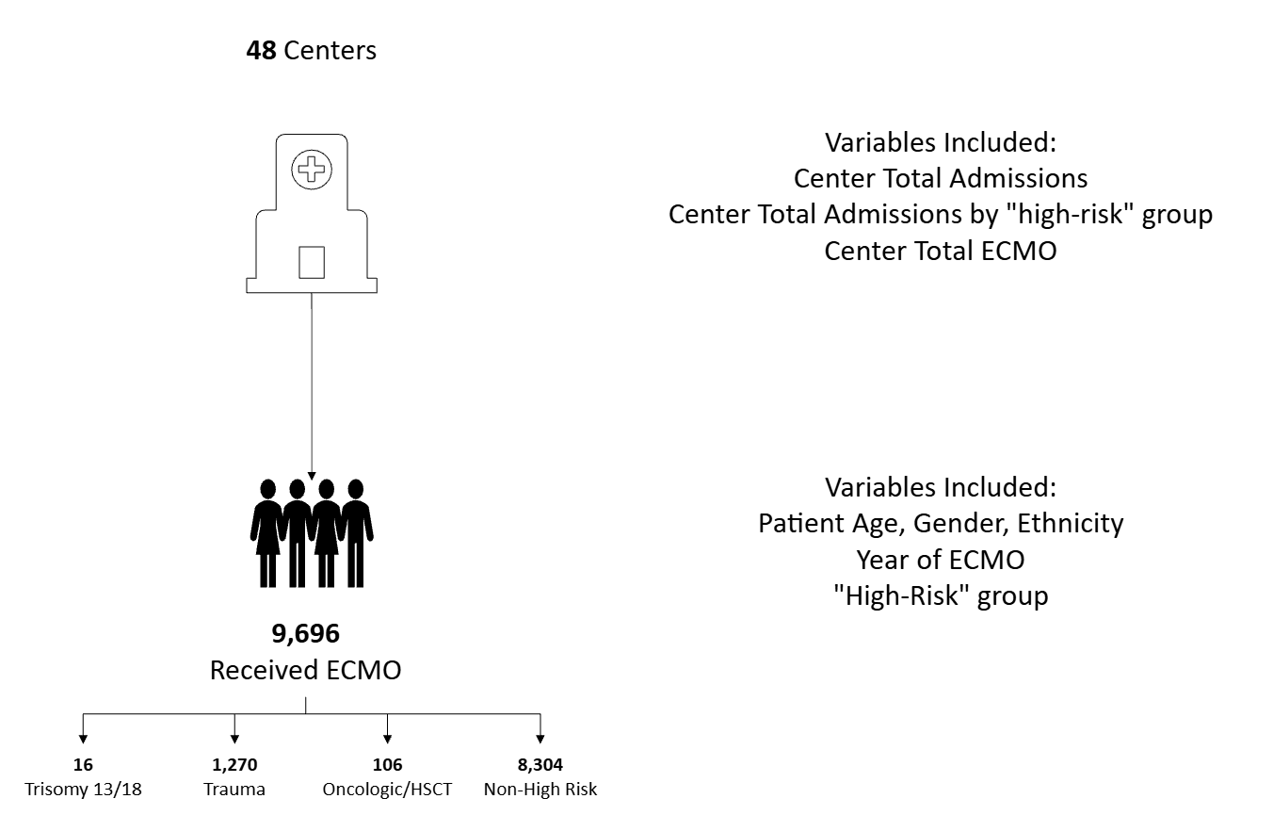
Making the model

Slide 59
Patient level factors that influence ECMO Utilization
Variable | Probability % (95% CI) | p-value
High-Risk Group
Trisomy 13/18 | 0.31 (0.19 – 0.50) | 0.001
Trauma | 1.51 (1.42 – 1.60) | <0.001
Oncologic/HSCT | 0.25 (0.20 – 0.30) | <0.001
Baseline | 0.70 (0.57 – 0.86) | <0.001
Other Patient Level Factors Included: Ethnicity, Gender, Patient Age, Year of ECMO
Unpublished Data
Notes:
ECMO Utilization as proportion:
Trisomy 13/18: 0.185%
Trauma: 13%
Onc/HSCT: 1%
Total: 1.12% of all admissions

Slide 60
Effect of Hospital Level ECMO on ECMO Utilization
ECMO Cases (2016 - 2024) | Probability % (95% CI) | p-value
200 | 0.8 (0.8 – 0.9) | <0.001
400 | 2.5 (2.1 – 2.9) | <0.001
600 | 7.0 (4.9 – 9.2) | <0.001
800 | 17.9 (10.1 – 25.0) | <0.001
1,000 | 37.7 (23.6 – 51.8) | <0.001
Interpretation: For every 200 ECMO Cases, the relative increase in probability of ECMO is ~250%
Unpublished Data
Notes:
Center Median ECMO (IQR): 250 (150 , 390)
99% : 530 cases / 8 years
1%: 12/ 8 years years

Slide 61
Effect of PICU Admissions on ECMO Utilization
PICU Admissions (2016 - 2024) | Probability % (95% CI) | p-value
10,000 | 2.8 (1.6 – 4.1) | 0.001
15,000 | 2.2 (1.4 – 2.9) | 0.001
20,000 | 1.7 (1.2 – 2.1) | <0.001
25,000 | 1.3 (1.1 – 1.5) | <0.001
30,000 | 1.0 (0.8 – 1.1) | <0.001
Interpretation: For every 5,000 patient admissions, the relative decrease in probability of ECMO is ~20%
Unpublished Data
Notes:
Center Median Admissions (IQR): 22,121 (15,439 , 29,756)
99%: Total Admissions = 54,479/ Total ECMO = ***/ proportion = ***%
1%: Total Admissions = 6,364/ Total ECMO = ***/ proportion = ***%

Slide 62
Acknowledgements
Ryan Barbaro MD, MSc
Erin Carlton MD, MSc
Stephen Gorga MD, MSc
Zubin Modi MD, MSc
Acham Gebremariam MS
Sarah Reeves PhD, MPH
Kao-Ping Chua MD, PhD
Susan B Meister & The Meister Foundation
Notes:
Data in our work likely pulls from the same pool of patients previously published
Given this it is possible that using administrative datasets such as PHIS may allow researchers to combine patient level and hospital level factors in hypothesis answering work regarding patient selection and outcomes on ECMO
ECMO utilization in high-risk populations has not changed significantly over time, limitation is that COVID did influence this and over coming years may find that there is a trend towards significance
Trauma patients likely do not need to be thought of any differently from a mortality risk standpoint for ECMO. T13/18 and Onc populations may present unique areas of thought when considering for candidacy. Hospital level factors may influence candidacy. Further evaluation tying candidacy/patient selection to outcomes may help elucidate how patient selection influences patient level outcomes

Slide 63
Questions
From a clinical perspective how do you think about the saliency of a differential risk of ECMO?
Recognizing the limitations of administrative datasets do you think that this work could be strengthened by controlling for ECMO candidacy/severity of illness?

Slide 64
References
Slide 3: Maratta C, Potera RM, van Leeuwen G, Castillo Moya A, Raman L, Annich GM. Extracorporeal Life Support Organization (ELSO): 2020 Pediatric Respiratory ELSO Guideline. ASAIO J. 2020;66(9):975-979. doi:10.1097/MAT.0000000000001223
Slide 4: MacLaren G, Conrad S,Peek G. Extracorporeal Life Support Organization (ELSO): 2015 Indications for Pediatric Respiratory Extracorporeal Life Support Maratta C, Potera RM, van Leeuwen G, Castillo Moya A, Raman L, Annich GM. Extracorporeal Life Support Organization (ELSO): 2020 Pediatric Respiratory ELSO Guideline. ASAIO J. 2020;66(9):975-979. doi:10.1097/MAT.0000000000001223
Slides 5: Kuo KW, Barbaro RP, Gadepalli SK, Davis MM, Bartlett RH, Odetola FO. Should Extracorporeal Membrane Oxygenation Be Offered? An International Survey. J Pediatr. 2017;182:107-113. doi:10.1016/j.jpeds.2016.12.025

Slide 66
Respiratory Failure Management Variation in Adolescents and Young Adults in Pediatric and Adult ICUs
Kevin Gochenour, MD
2nd year PCCM Fellow
February 18th, 2026

Slide 67

Research Career Motivation
Career Goal: Develop evidence-based unified adolescent & young adults (AYA) guidelines for ICU service line triage & care via CAYACC
Mission: Advance AYA critical care outcomes through collaboration of pediatric & adult ICU teams
Vision: Improve health care delivery for AYA in the ICU
Notes:
My career goal is to develop evidence-based triage and treatment guidelines for AYA in the pediatric & adult ICUs, via a group of like-minded pediatric & adult ICU physician’s and researchers I named CAYACC.
CAYACC’s mission is to improve AYA critical care outcomes through collaboration among pediatric & adult ICU doctors and researchers.
CAYACC’s vision is to improve health care delivery for AYA suffering from critical illness.

Slide 68



18 – 25y old with
Respiratory Failure
Which ICU is a complicated multifactorial decision
No guideline or standard of care to guide this decision
Where the patient ends up can result in different care for the same patient
Pediatric ICU
?
Adult ICU
Notes:
To frame our discussion, consider a patient aged 18 to 25 years old who develops respiratory distress, which progresses to respiratory failure requiring ICU admission…
In Scenario 1: Our patient is admitted to a pediatric ICU and develops severe ARDS defined by PALICC guidelines using OI, with poor compliance, and receives a Tidal Volume of 4-6 mL/kg consistent with guidelines for pARDS care…
In Scenario 2: Our patient is admitted to an adult ICU, and develops severe ARDS defined by ATS guidelines using P/F ratio, with poor compliance, and receives a Tidal Volume of 4-8 mL/kg consistent with guidelines for ARDS care…
The admission decision of Pediatric or Adult ICU for AYA is complicated and multifactorial, with no guideline or established standard of care upon which this decision is based… as a result, these decisions can vary dramatically between institutions, AND where the patient ends up matters!! because the care they receive in these two environments is different.

Slide 69
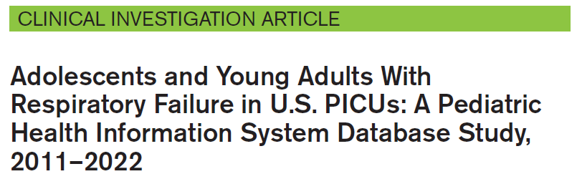



AYA aged patients are a minority population in ARDS studies
Age 18
Contribution to n
Medically Complex
%
Dec age
Increasing Age
AYA
Greater Mortality
Age 3 ± 1 years
Age 56 ± 16 years
PALISI – Prone Positioning
PARDIE
Oxy-PICU
OSCILLATE
ARDSNet Tidal Volume
PROSEVA
More resource intensive
Gochenour KS, Ross MH, Flori HR, Kohne JG. Adolescents and Young Adults With Respiratory Failure in US PICUs: A Pediatric Health Information System Database Study, 2011–2022. PCCM. 2025.
Notes:
My previous work showed that Adolescents & Young Adults in the PICU represent a phenotypically distinct population compared to younger PICU patients that are; more medically complex… experience greater mortality… and are more resource intensive…
Existing research struggles to generalize findings to AYA patients for multiple reasons:
Major adult ARDS trials enroll patients with a median age of 56 +/- 16 years, while in pediatric studies the median age is 3 +/- 1 year….
Thus, the contributions of AYA patients to the average treatment effect are drowned out by the contributions of OLDER or YOUNGER patients… Resulting in guidelines which poorly generalize to AYA patients in either ICU setting

Slide 70
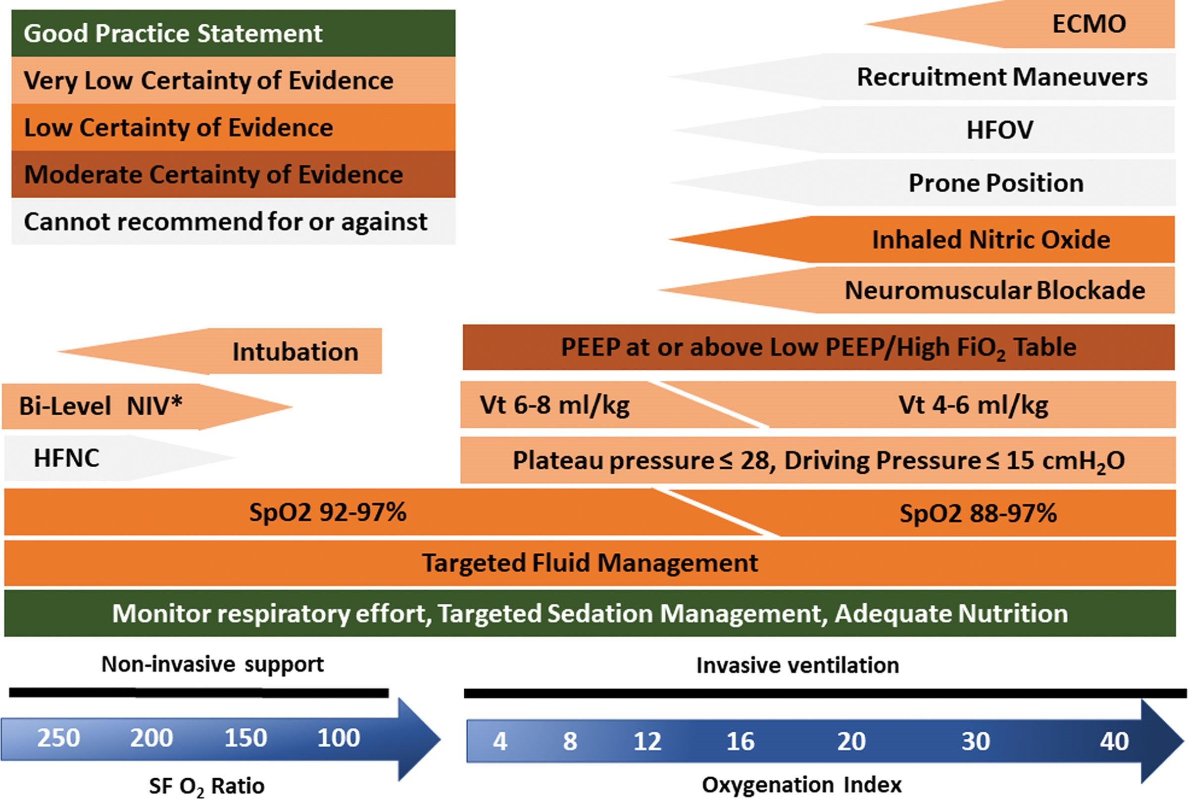
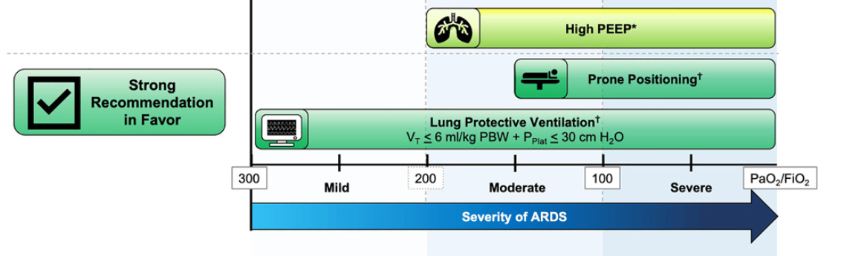
We hypothesized pediatric & adult ICUs use different ventilator strategies for AYA
Pediatric ICU PALICC-2 c. 2023
Adult ICU ATS – 2023 Update
Per PALICC-1 Guidelines c. 2015
Per ATS-2017 Guidelines
Tidal Volume:
5–8 mL/kg PBW
Allowance of 3 – 6 mL/kg PBW to maintain P_{PLAT} ≤ 28 cm H₂O
PEEP 10 – 15 cm H₂O; >15 cm H₂O in severe pARDS
Tidal Volume:
4–8 mL/kg PBW
Allowance for < 4 mL/kg PBW to maintain P_{PLAT} ≤ 30 cm H₂O
Use “higher” rather than “lower” PEEP for moderate & severe ARDS
Notes:
Given the complexity of how AYA are admitted to the ICU, we hypothesized AYA in the adult & pediatric ICU are likely not a homogenous population…
We hypothesized that adult & pediatric ICUs use different ventilator strategies for AYA as the guidelines for ARDS management are not the same…
For the remainder of this talk I will refer to PALICC-1 and ATS-2017 guidelines as they are most relevant to the time period we studied…
There are many differences between pediatric & adult ARDS guidelines, some more stark than others, for the purposes of our discussion today the differences I want to focus on specifically are, Tidal Volume and PEEP for FiO2…
While both the pediatric and adult ICU tidal volumes are similar, and focus on a central goal of 6 mL/kg the allowance for deviations in the guidelines have different ranges and motivations…
Both the pediatric and adult ICU recommend increasing PEEP for higher FiO2, although the recommendations for what PEEP to choose is different

Slide 71
* Preliminary unpublished data
Please do not share
University of Michigan Health System Data
01/01/2015 to 12/31/2024
18 to 25 yo w/ acute hypoxic respiratory failure in a non-cardiac ICU who require IMV
Population size
Pediatric ICU 130 (20%) vs. Adult ICU 551 (80%)
Patients in the pediatric ICU compared to the adult ICU:
Younger median age 19, IQR (18 – 21) vs. 23, (21 – 24); p<0.001
Lower median IBW 59 kg, IQR (50 – 70) vs. 66 kg, (55 – 75); p<0.001
Greater median Elixhauser Comorbidity Index 22, (14 – 33) vs. 15, IQR (4 – 26); p<0.001
Admission diagnoses did not vary significantly in the pediatric & adult ICU
Notes:
University of Michigan is uniquely positioned for AYA research as the adult and pediatric hospitals are on the same medical campus and use the same EHR…
From an original cohort of 1,348 patients, we excluded patients with chronic respiratory failure, defined as those with a tracheostomy without a tracheostomy procedure in the same admission, OR those with an ICD-9/10 diagnosis code for chronic respiratory failure… AND patients with a P/F ratio greater than 300
Yielding a final cohort of 681 patients age 18 to 25, with acute hypoxic respiratory failure, admitted to a non-cardiac ICU, who required invasive mechanical ventilation, over the 9 years studied…
130 in the pediatric ICU & 551 in the adult ICU…
To test our hypotheses, we measured many demographic factors which might influence the decision to admit a patient to either a pediatric or adult ICU, such as age, ideal body weight, reason for ICU admission, and burden of complex chronic disease…
PICU AYA tended to be younger, 10 kg lighter, and have a greater burden of complex chronic conditions than adult ICU AYA…
Pediatric and adult ICU AYA had similar rates of pulmonary related admission diagnoses
----------------------------------------------------------------------------------------------------------------------------------------------------------------------------------------------------------
THIS IS HERE FOR REFERENCE IF NEEDED:
Chronic Respiratory Failure ICD-10 Codes
Chronic Ventilator Dependance with Hypoxia & Hypercarbia Respiratory Failure = J96.11 and J96.12
Dependance on enabling machines / devices = Z99.89, which AAPC defines as the code used for BiPAP, CPAP, or “other” respirators
Arterial line use in adult ICU was 424 (77%), pediatric ICU 93 (72%), univariate p = 0.19
Patients excluded with P/F > 300 = 434 (76%) adult ICU patients; 137 (24%) pediatric ICU patients…
Rates of heart failure, complicated hypertension, other neurologic diseases, renal failure, hematologic malignancy, and fluid & electrolyte disorders were all significantly higher in the Pediatric ICU….
… and the rate of obesity was significantly higher in the adult ICU…
Proportion of populations with chronic lung disease:
Using Elixhauser = Chronic Pulmonary Disease: Adult = 112 (20%); Pediatric = 28 (22%), univariate p = 0.76
Using CCC = Respiratory: Adult = 86 (16%); Pediatric = 15 (12%), univariate p = 0.24

Slide 72
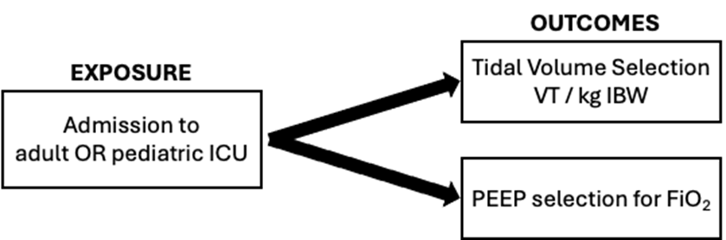
* Preliminary unpublished data
Please do not share
Factors influencing management choices in first 24 hours of IMV in both ICUs
Markers of hypoxic defect tell different story between pediatric & adult ICU:
Similar median P/F ratio 170, IQR (105 – 233) vs. 170, (99 – 233); p=0.53
Higher median OI of 5, IQR (3 – 12) vs. 4, (2 – 8); p=0.007
Vent & Lab Data that was significantly different between pediatric & adult ICU:
Lower median MVe 7 L/min, IQR (6 – 10) vs. 8, (6 – 10); p=0.037
Lower median Arterial pH 7.37, IQR (7.33 – 7.42) vs. 7.40, (7.36 – 7.44); p=0.004
Notes:
Our primary outcome measures were the tidal volume per kg of IBW… and PEEP selected for FiO₂ in the first 24 hours of IMV… we also measured many factors which might influence IMV management choices…
Like SOFA score, P/F ratio, estimated dead space fraction, Minute Ventilation, Dynamic Compliance, and many lab markers of organ function and dysfunction…
Median P/F ratio was similar in the pediatric & adult ICUs, as were the severity of hypoxia categories based on P/F ratio… however, using OI the story was different… with pediatric ICU patients having a slightly higher OI than adult patients….
The only major ventilator & lab related differences between pediatric and adult ICU AYA was lower median minute ventilation, and lower median arterial pH

Slide 73
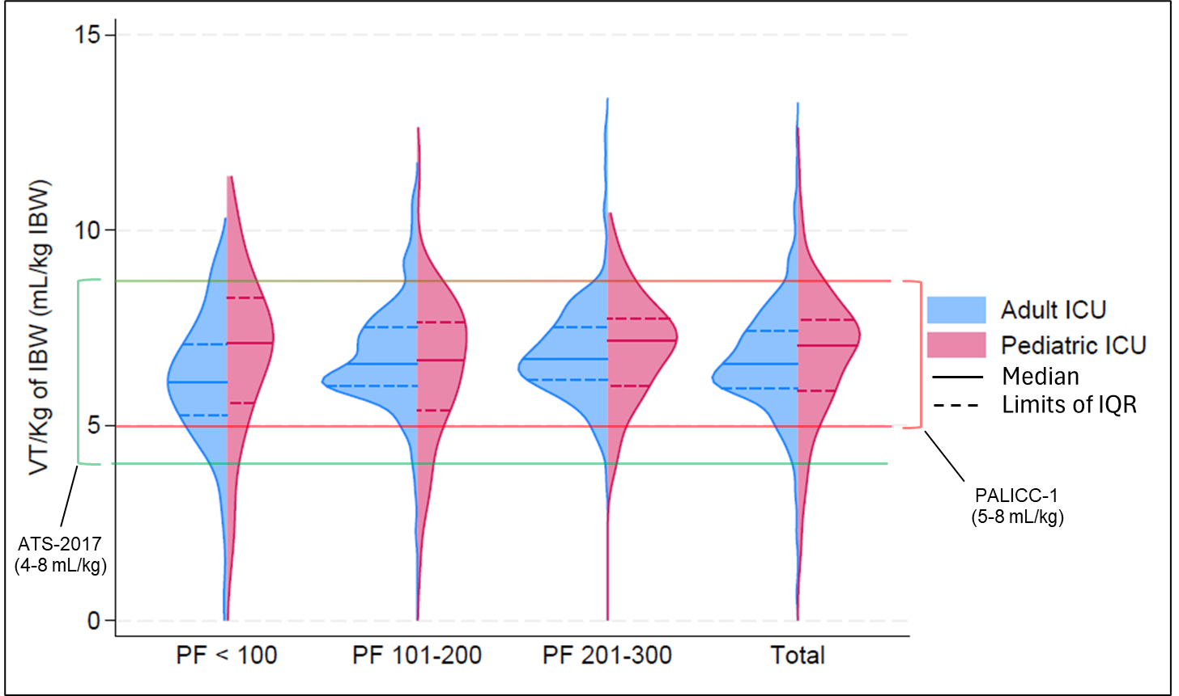
AYA Receive Larger Tidal Volumes in the Pediatric ICU
* Preliminary unpublished data
Please do not share
All p<0.05
Notes:
These are violin plots of median tidal volume per kg of IBW in the first 24 hours after initiation of IMV shown on the Y axis… with adult ICU patients in blue… and pediatric ICU patients in red… each plot is grouped by hypoxia severity on the x-axis based on Berlin Criteria categories… most severe on the left and least on the right, and total population on the extreme right…
As a visual guide the ATS-2017 recommended tidal volume range is shown in green bars, while the PALICC-1 recommendations are shown in red bars…
The median for each group is indicated with a solid line, and dashed lines show the limits of the interquartile range…
Tests for significance between groups were conducted using quantile linear regression controlling for multiple factors…
AYA in the pediatric ICU receive larger tidal volumes than in the adult ICU by as much as 0.5 mL/kg IBW…
…this effect was greatest in the patients with the largest hypoxic defect which was larger in the PICU by 1.3 mL/kg IBW and was also true for patients with the smallest hypoxic defect...
It would be interesting to know more about the patients above the 75th percentile with a P/F ratio < 100 in both ICUs, who likely account for much of the difference in patients above 8 mL/kg in the pediatric ICU as a whole

Slide 74
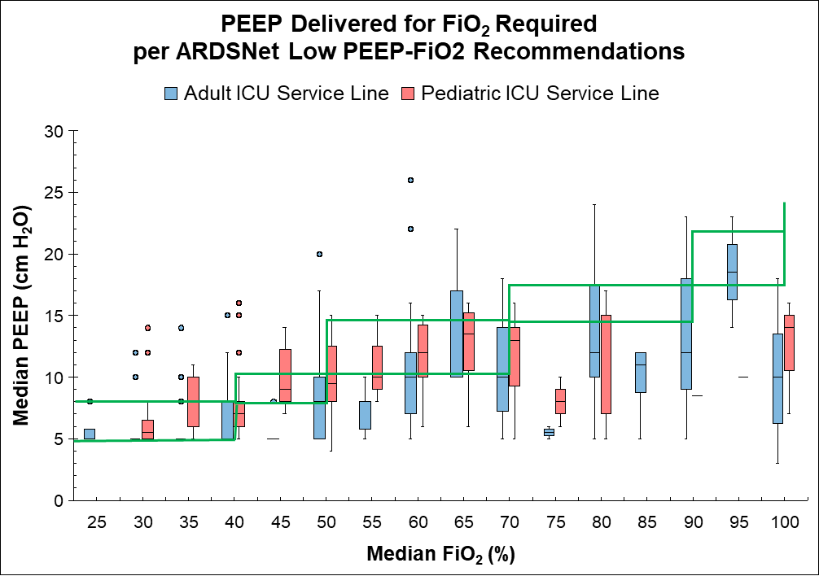
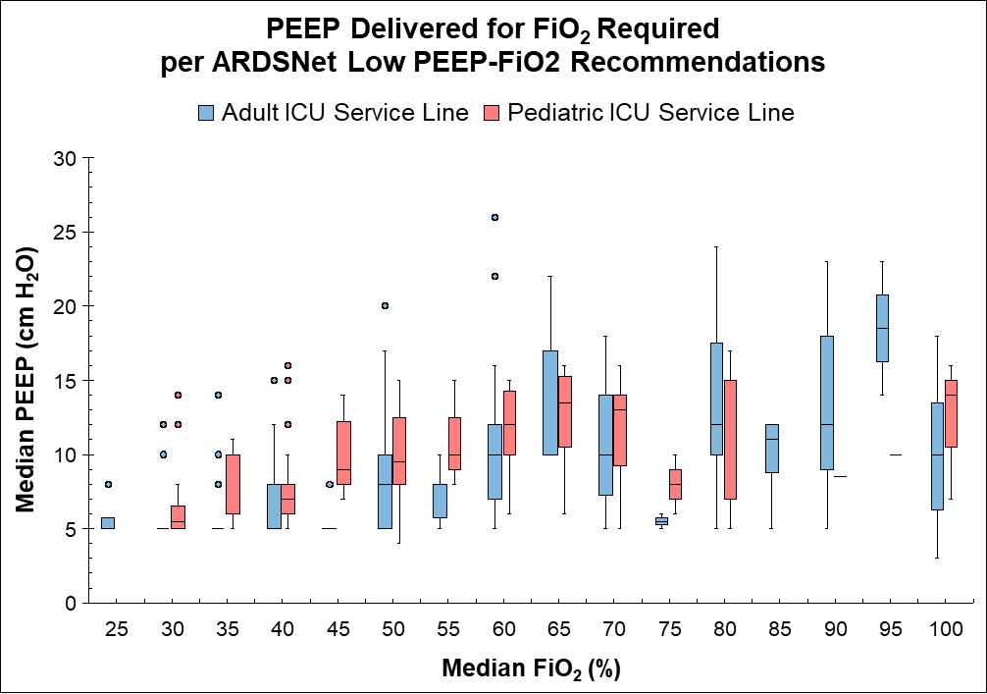
AYA Receive Higher PEEP for FiO₂ in the Pediatric ICU
Adult & Pediatric ICUs are Below Grid at Higher FiO₂
ARDSNet Low PEEP-FiO₂ Recommendations
* Preliminary unpublished data
Please do not share
All p<0.01
Notes:
These are box and whisker plots of median PEEP on the Y axis… and median FiO2 on the X axis… in the first 24 hours after initiation of IMV… adult ICU patients are still in blue… pediatric ICU patients are still in red…
As a visual guide the ARDSNet Low-PEEP High FiO2 recommendations are shown within the green boxes…
Tests for significance between adult & pediatric ICU patients, were conducted using quantile linear regression controlling for multiple factors, and median PEEP and median FiO2 were treated as continuous variables…
AYA in the pediatric ICU receive a higher median PEEP than in the adult ICU by 1.5 cm of water pressure for a similar FiO2, which is best demonstrated in the groups with an FiO2 below 75%, which is easier to see if I remove the ARDSNet recommendations…
As you can see here… ***PAUSE FOR EFFECT***…
Above an FiO2 of 65% both ICUs tend to use PEEP lower than ARDSNet recommendations, however, the adult ICU tended to provide a higher median PEEP in this range… we did not have enough patients in each FiO2 group for a direct comparison of medians in this dataset

Slide 75



Outcomes for AYA are Different in the Pediatric & Adult ICUs
Unadjusted outcomes are different in pediatric & adult ICUs
Longer median vent days 6, IQR (2 – 15) vs. 3, IQR (1 – 8); p<0.001
Longer median ICU length of stay 13, IQR (5 – 26) vs. 8, IQR (4 – 16); p<0.001
Trend towards higher median 30-d mortality 29, (22%) vs. 86, (16%); p=0.067
* Preliminary unpublished data
Please do not share
Notes:
Patient centered outcomes in the pediatric and adult ICUs for AYA at our institution are different…
AYA in the PICU spent more days on the ventilator…
AYA in the PICU spent more days in the ICU…
And AYA in the PICU had a trend toward higher 30-day mortality rate…

Slide 76
AYA receiving IMV in the Pediatric & Adult ICUs at our institution ARE NOT homogenous, receive different care, and have different patient centered outcomes
We need to meet AYA where they are… NOT about who does it better!
AYA-centric guidelines allow for the BEST care no matter what ICU an AYA patient is admitted to!
Next steps
Propensity score analysis for patient weighting in regression models
Fuzzy discontinuity regression to validate current findings
Notes:
Mechanically ventilated AYA in the Pediatric & Adult ICUs at our institution have differences…
We don’t know if care variation leads to different patient centered outcomes… we need to understand what guidelines are BEST for AYA in the ICU… Is it adult or pediatric guidelines or portions from both? These are all major questions I hope to answer…
The use of propensity score weighting will control for unmeasured confounding for these patients, and agreement between fuzzy discontinuity regression and our current findings would strengthen these results…

Slide 77

Future Projects
Scale up current research to a larger database like CLIF or Epic Cosmos…
AYA admission to ICU, how have trends changed with time and why – are more AYA being admitted to PICUs because of loss of access to rural hospitals, and loss of community PICUs with time?
Is increased time spent receiving guideline concordant care associated with improved outcomes for AYA with ARDS requiring IMV in the pediatric & adult ICU?
Notes:
Using the CLIF database, scale up my current research, using similar methodology, and describe the IMV care variation for AYA in adult & pediatric ICUs at multiple institutions across the US…
Another idea is to evaluate what factors determine which ICU AYA are triaged to… and how those patterns have changed with time… as hospital resources have dwindled at the national level, particularly with loss of rural hospitals… this could be a two-tier project at the local level first and the national level second…
A third idea is whether greater time spent receiving guideline concordant care is associated with improved outcomes for AYA with respiratory failure in the pediatric & adult ICUs… this could be designed almost as a “cross over” study, where we test if time spent in concordance with pediatric guidelines in the PICU is associated with better outcomes, compared to time spent in concordance with adult guidelines in the PICU and vice versa for the adult ICU…

Slide 78






Scholarly Oversight Committee
Heidi Flori, MD, FAAP
Erin Carlton, MD, MSc
Michael Sjoding, MD, MSc
Clinical Professor, PCCM
Wiel Institute Associate Director
Primary SOC Mentor
Associate Professor, PCCM
Associate Director of CHEAR Fellowship Programs
Associate Professor, Pulm Crit
IHPI Faculty
Joseph Kohne, MD, MSc
Ryan Barbaro, MD, MSc
Kao-Ping Chua, MD, PhD
Assistant Professor, PCCM
University Hospitals – Rainbow
Associate Professor, PCCM
CHEAR Faculty Investigator
Associate Professor, Pediatrics
CHEAR Director

Slide 79

Feedback & Questions

Slide 80
Prompts for Feedback
What do you think is the most compelling aspect of this project?
If asked to review these data in a manuscript, what would be your primary concerns?
From the perspective of what project to tackle next, which of my proposed projects if any are most compelling to you?

Slide 81
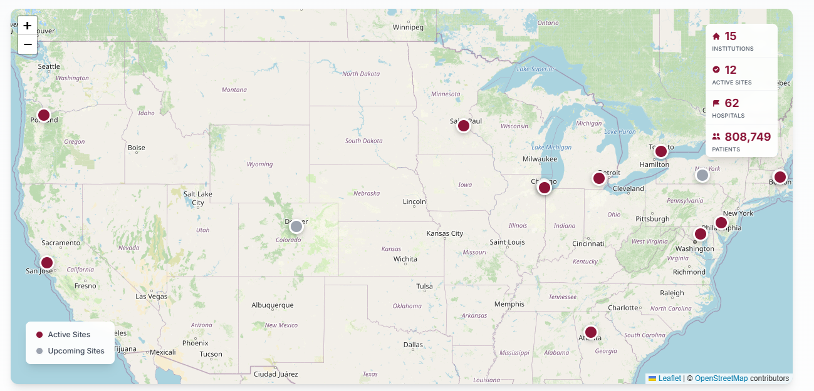

Common Longitudinal ICU Format (CLIF)

Slide 82

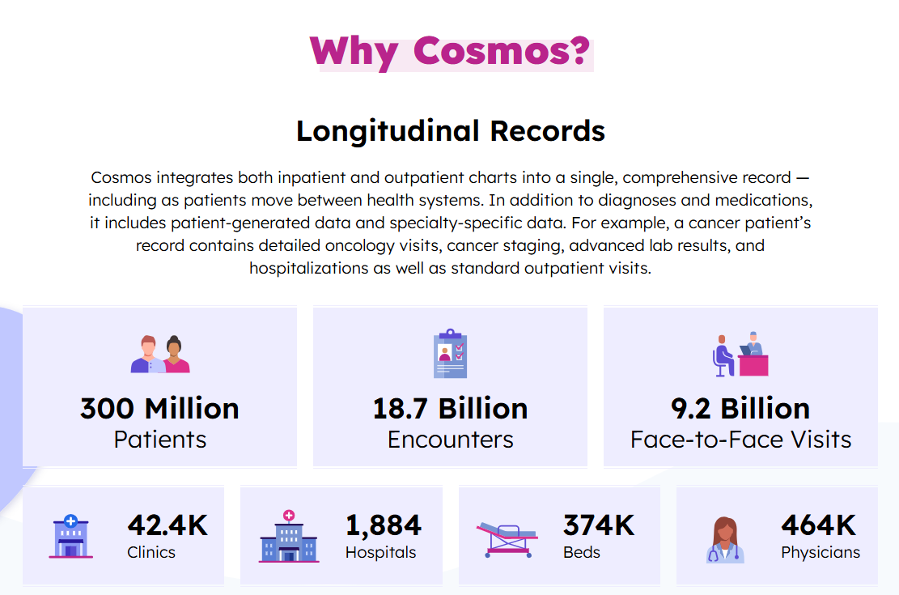
Epic Cosmos

Slide 83
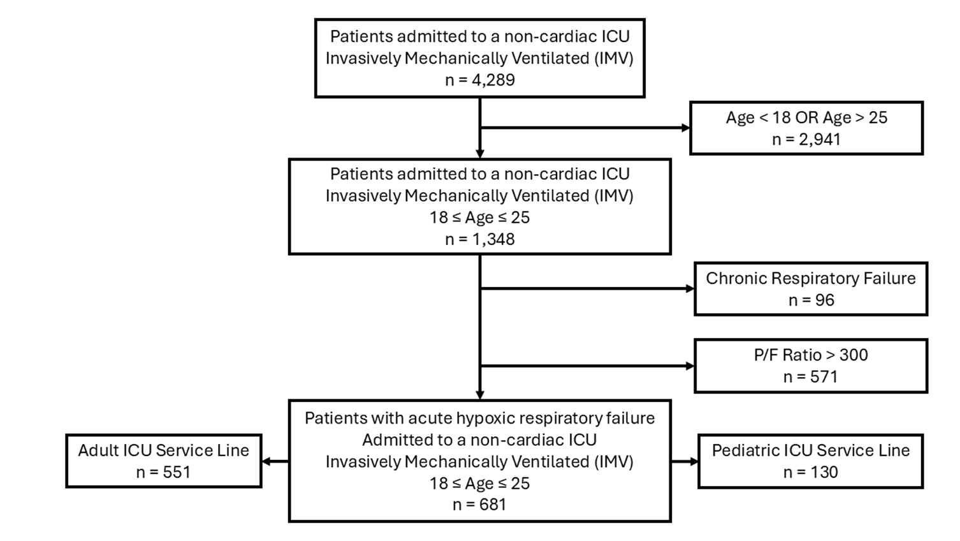
University of Michigan Health System Data
01/01/2015 to 12/31/2024
Notes:
University of Michigan is uniquely positioned for AYA research as the adult and pediatric hospitals are on the same medical complex and use the same EHR
Our study identified 1,348 patients who were admitted to a non-cardiac ICU at the University of Michigan and required invasive mechanical ventilation over the 9-years studied that were between the ages of 18 and 25…
We excluded patients with chronic respiratory failure, defined as those with a tracheostomy without a tracheostomy procedure in the same admission, OR those with an ICD-9/10 diagnosis code for chronic respiratory failure… AND patients with a P/F ratio greater than 300 (434 (76%) adult ICU patients; 137 (24%) pediatric ICU patients)
Yielding a final cohort of 681 patients age 18 to 25, with acute hypoxic respiratory failure, admitted to a non-cardiac ICU who required invasive mechanical ventilation…
551 patients admitted to the adult ICU service line & 130 patients admitted to the pediatric ICU service line

Slide 84
ICU Service Line n, (%) |  |  | ADULT | PEDIATRIC | p
 |  |  | 551, (83) | 130, (19)
 | Age (years) |  | 23, (21–24) | 19, (18–21) | <0.001
 | Ideal Body Weight (kg) |  | 66, (55–75) | 59, (50–70) | <0.001
 | Elixhauser Comorbidity Index Score |  | 15, (4–26) | 22 (14–33) | <0.001
 |  | Chronic Pulmonary Disease n, (%) | 112, (20) | 28, (22) | 0.76
 | Admission Diagnosis n, (%)
 |  | Pulmonary Infections | 173, (31) | 45, (35) | 0.48
 |  | Asthma | 84, (15) | 23, (18) | 0.49
 |  | Aspiration | 107, (19) | 18, (14) | 0.14
 |  | Other Respiratory Infections | 75, (14) | 17, (13) | 0.87
 | SOFA Score |  | 9, (6–12) | 9, (7–12) | 0.079
 | P/F Ratio |  | 170, (99–233) | 170, (105–233) | 0.53
 | 24 hours after initiation of mechanical ventilation
 |  | Oxygenation Index | 4, (2–8) | 5, (3–12) | 0.08
 |  | Minute Ventilation (L/min) | 8, (6–10) | 7, (6–10) | 0.037
 |  | Estimated Dead Space Fraction | 28, (16–42) | 34, (20–48) | 0.089
 |  | Arterial pH | 7.4, (7.36–7.44) | 7.4, (7.33–7.42) | 0.004
 |  | Arterial Lactate (mmol/L) | 1.7, (1.1–3.1) | 1.9, (1.3–3.6) | 0.077
Notes:
PICU AYA tended to be younger, 10 kg heavier, and have a greater burden of complex chronic conditions than adult ICU AYA
Pediatric and adult ICU AYA had similar rates of pulmonary related admission diagnoses
The only major IMV & lab related differences between pediatric and adult ICU AYA for the first 24 hours after initiation of IMV was slightly lower minute ventilation, and slightly lower arterial pH

Slide 85
Elixhauser & CCC are different
Category | Adult |  | Pediatric |  | p
 | 551 | 81% | 130 | 19%
Heart Failure | 86 | 16% | 30 | 23% | 0.042
Complicated HTN | 53 | 10% | 22 | 17% | 0.017
Other Neuro Dis | 102 | 19% | 44 | 34% | <0.001
Renal Failure | 52 | 9% | 21 | 16% | 0.026
Hem Malignancy | 35 | 6% | 18 | 14% | 0.004
Obesity | 117 | 21% | 15 | 12% | 0.012
Fluid & Elec Dis | 341 | 62% | 102 | 78% | <0.001
Category | Adult |  | Pediatric |  | p
 | 551 | 81% | 130 | 19%
Neurologic | 158 | 29% | 53 | 41% | <0.001
Metabolic | 231 | 42% | 72 | 55% | 0.005
Gastrointestinal | 158 | 29% | 55 | 42% | 0.003
Heme & Immuno | 111 | 20% | 66 | 51% | <0.001
Oncologic | 126 | 23% | 49 | 38% | <0.001
Other Congenital | 97 | 18% | 37 | 28% | 0.005
Transplant | 69 | 13% | 31 | 24% | 0.001

Slide 86
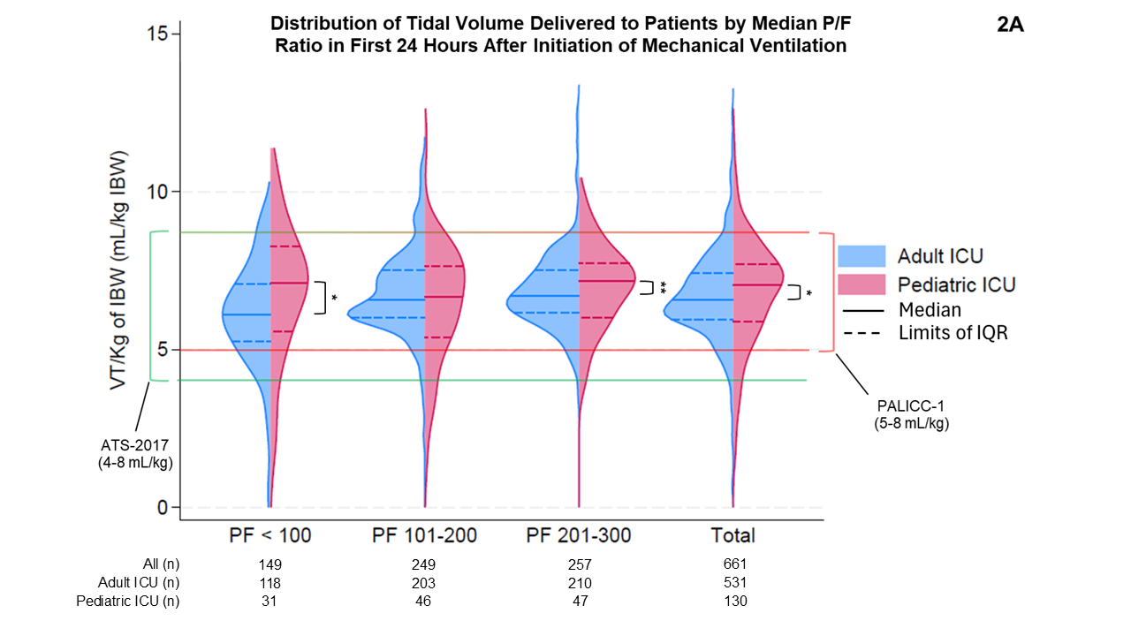
Controlling for:
Presence of chronic pulmonary disease
Median SOFA score, oxygenation index, minute ventilation, estimated dead space fraction, and arterial pH and lactate all within 24 hours of initiation of invasive mechanical ventilation
* = p < 0.05 | ** = p < 0.01 | *** = p < 0.001
Using quantile regression
Notes:
For short presentations, present the take away, what is the one sentence result that you want the audience to remember… like one big point per slide, that is the title… you don’t need the descriptive title, get rid of the table, make the things you controlled for smaller, takes away from the figure
Maybe get rid of the controlled for stuff, or very very small, you could also just say it… keep this figure at the end if people ask for it at the end
The verbal walk through was good, maybe describe what the control group would be, doesn’t have to be a lot but a small description, talking about future work takes away from what your talking about, maybe keep it just for the very end
For AYA in the pediatric ICU compared to the adult ICU larger tidal volumes were delivered overall, this seems to be driven mainly in the most severe and least severe patients.
This analysis was completed using quantile regression, further analysis will take place using propensity score weighting to control for confounding between the adult and pediatric ICU patients.
Additional analysis will take place separately using the fuzzy discontinuity regression for this outcome as well.

Slide 87
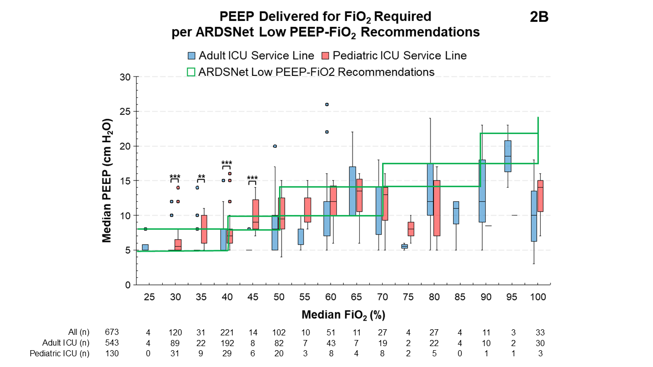
Controlling for:
Presence of chronic pulmonary disease
Median SOFA score, FiO₂, oxygenation index, minute ventilation, estimated dead space fraction, and arterial pH and lactate all within 24 hours of initiation of invasive mechanical ventilation
* = p < 0.05 | ** = p < 0.01 | *** = p < 0.001
Using quantile regression
Notes:
Same thing here for the title as previous slide, the arrows are a plus minus really, get rid of the table, and the controlling for etc, so you can focus on the figure
If arrows stay have them appear where your talking
You’re going to have talk through the figure more completely, increase the size of the figure, arrows might actually help with the verbal walk through
Using quantile regression, the pediatric ICU tends to use higher PEEP overall than in the adult ICU, this is driven primarily in the larger amount of data available for patients whose median FiO2 was less than 65%.
Once controlling for unmeasured confounding using propensity score weighting we hope to complete a more robust analysis of this data, we also intend to use fuzzy discontinuity regression for this outcome as well.

